Slide 1
Advanced Matplotlib

Slide 2
Summary
This lecture covers advanced matplotlib plotting with applications in finance.
We will create new charts and learn new techniques
Connect to Yahoo Finance API
Fill in plots
Create candlestick plots
Advanced technique for changes features of the axis
Change color and formatting of axis lines
Rotate x-axis labels
Change number of x-axis ticks
Pick any color you want

Slide 3
Imports + Installs
For accessing Yahoo Finance API

Slide 4
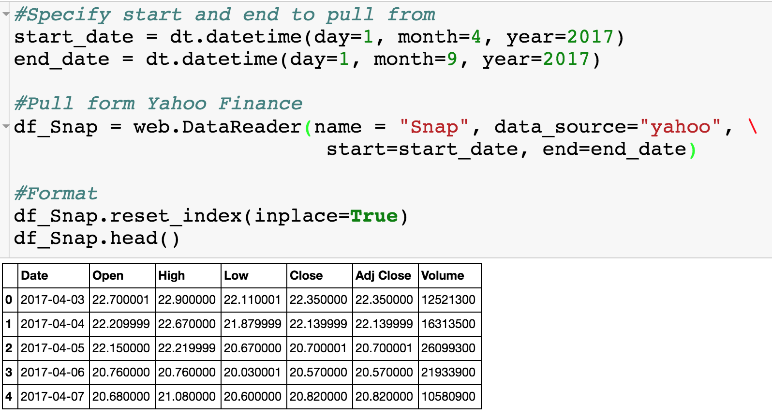
Yahoo Finance API – Snapchat

Slide 5
Yahoo Finance API - Snapchat
Unfortunately, matplotlib doesn’t like dates so we have to convert!

Slide 6
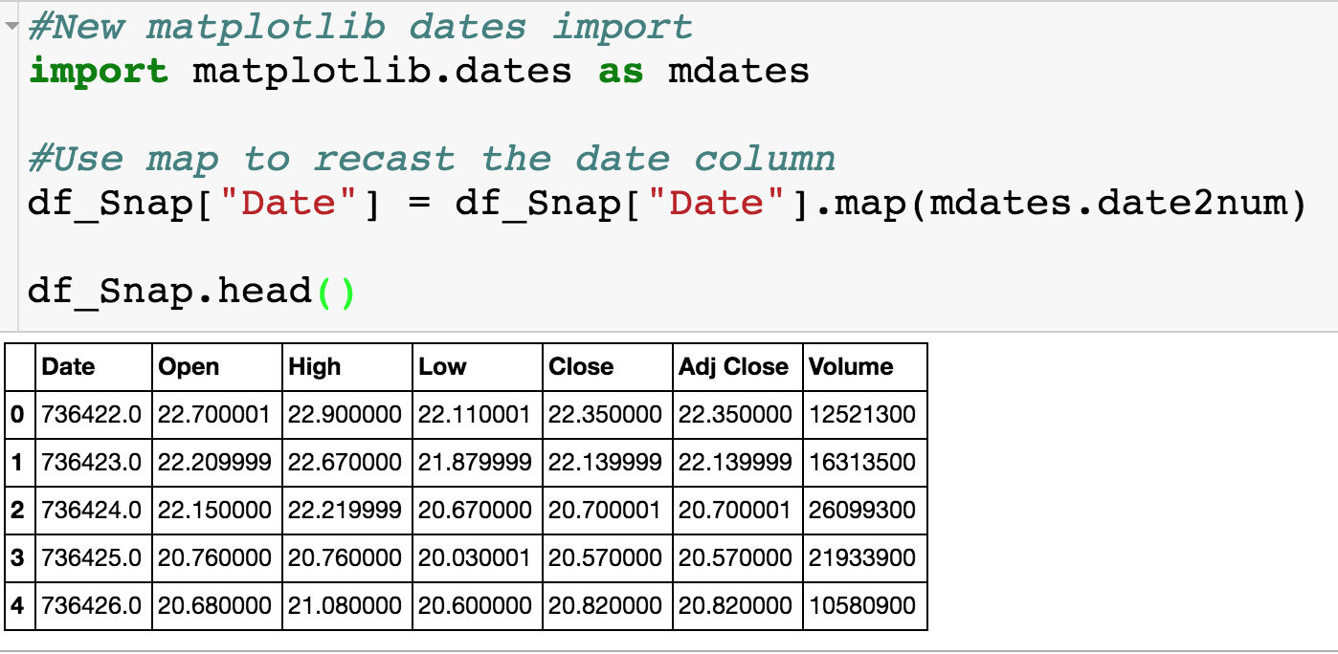
Matplotlib Dates
Weird 700K date format…If you want to work with dates in matplotlib, you will have to do this everytime.

Slide 7
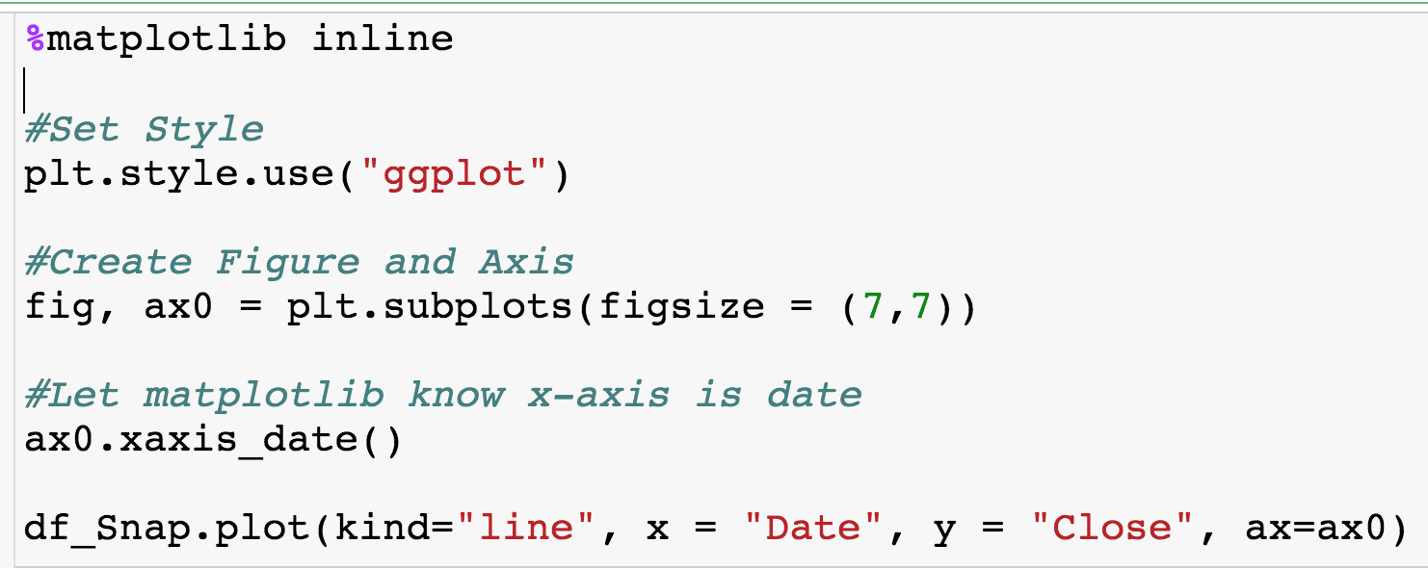
Plotting Closing Price
Also necessary when plotting dates on x-axis

Slide 8
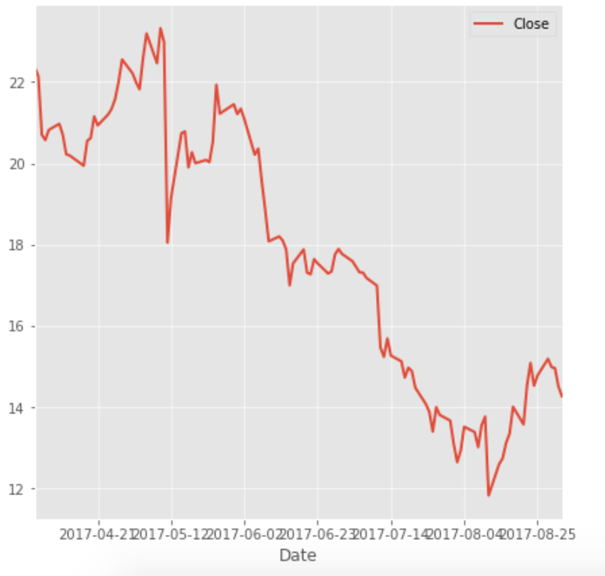
Plotting Closing Price
Here is the plot we get
The formatting on the x-axis looks horrible!
Want to tilt labels at 90 degree angle.

Slide 9
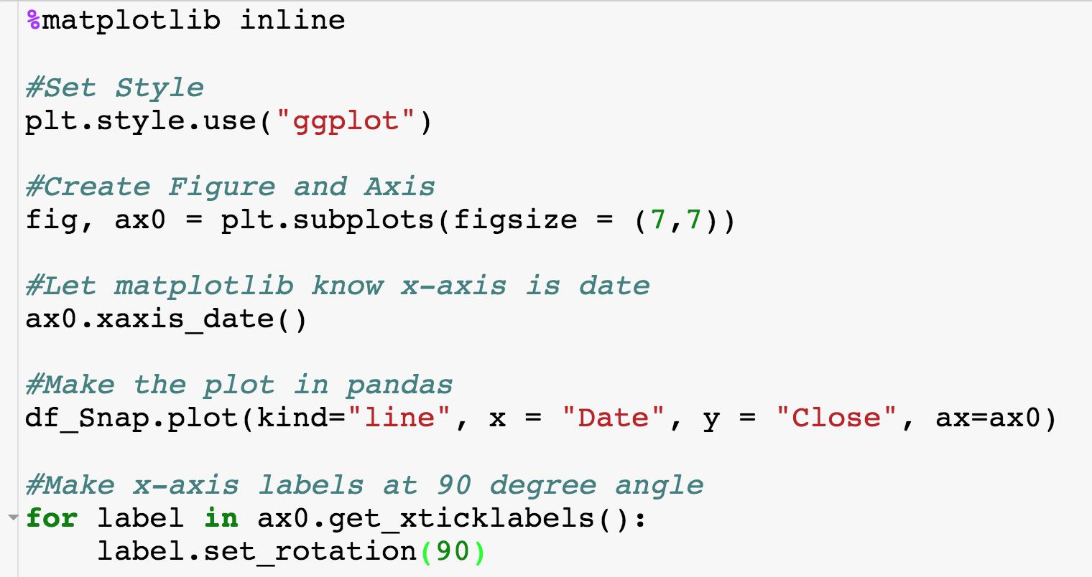
Rotating Axis Labels
Put whatever angle you want!

Slide 10
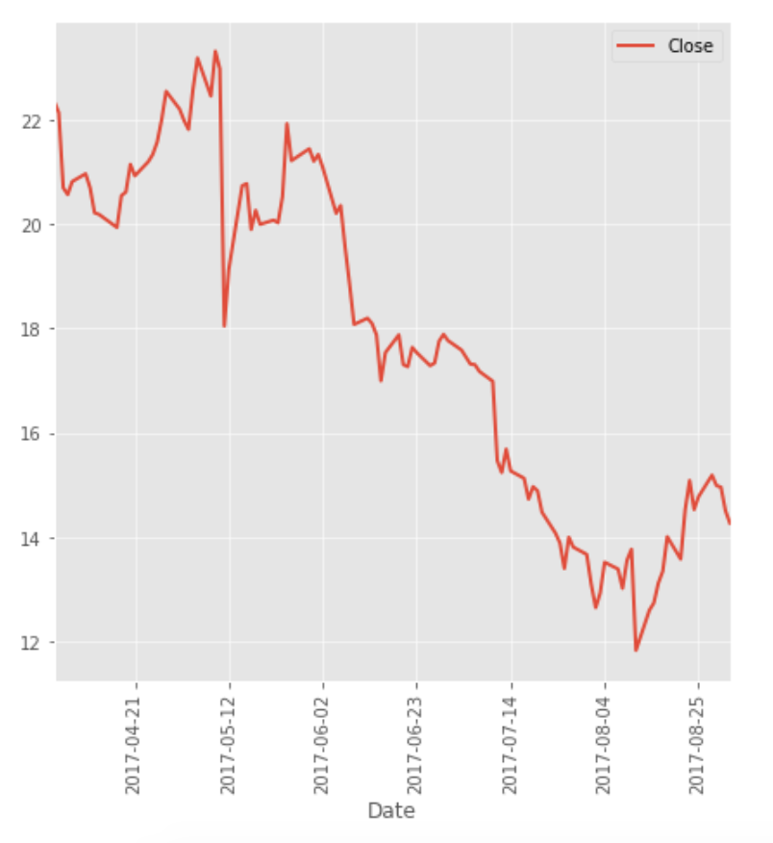
Rotating Axis Labels
Resulting Plot:

Slide 11
Format Axis More - Spines
“left” Spine of axis
Other three spines: “right”, “top” and “bottom”.

Slide 12
Format Axis More - Spines
Hex color code…more on this later.

Slide 13
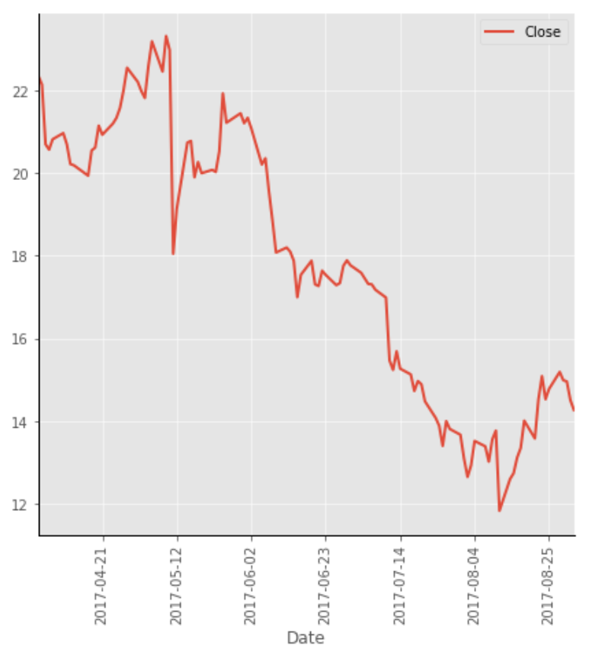
Format Axis More - Spines

Slide 14
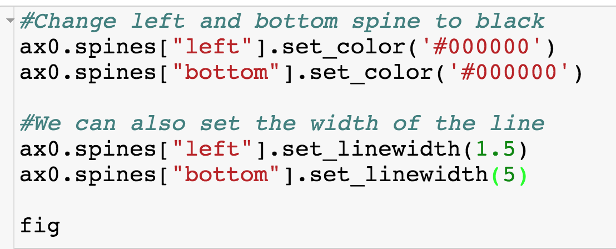
Format Axis More - Spines
Input is just a number to be played with.

Slide 15
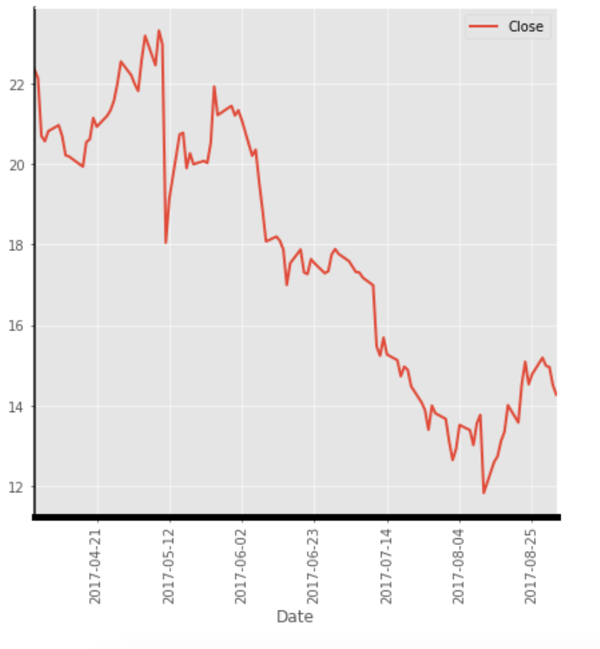
Format Axis More - Spines

Slide 16
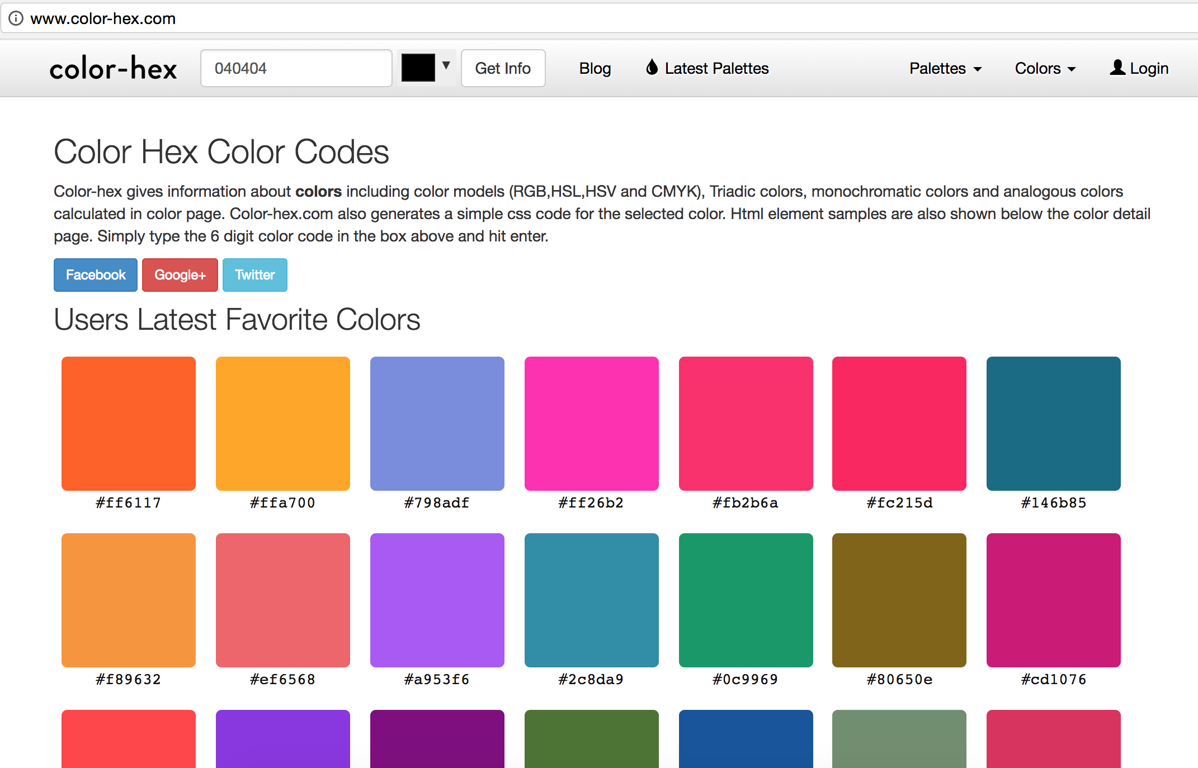
Hex Colors
Hex colors work anywhere there is a colors input.

Slide 17
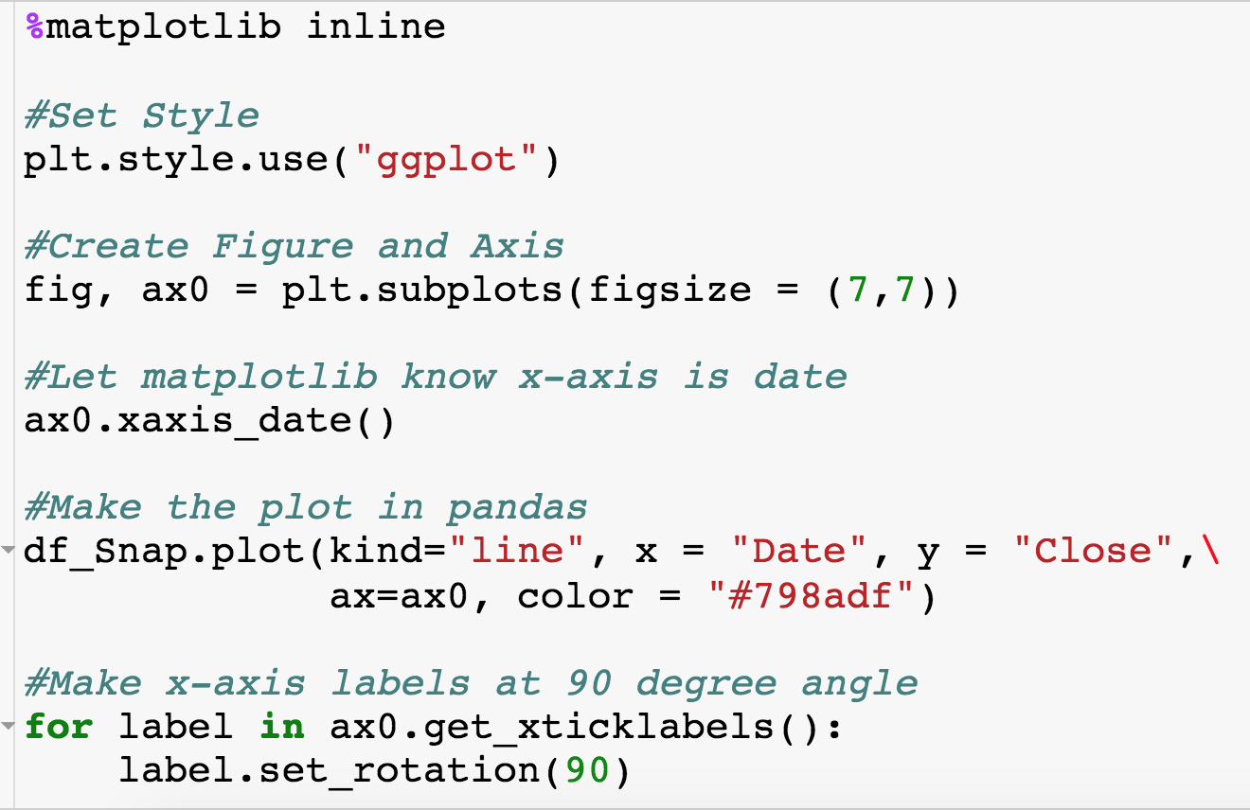
Hex Colors
New color

Slide 18
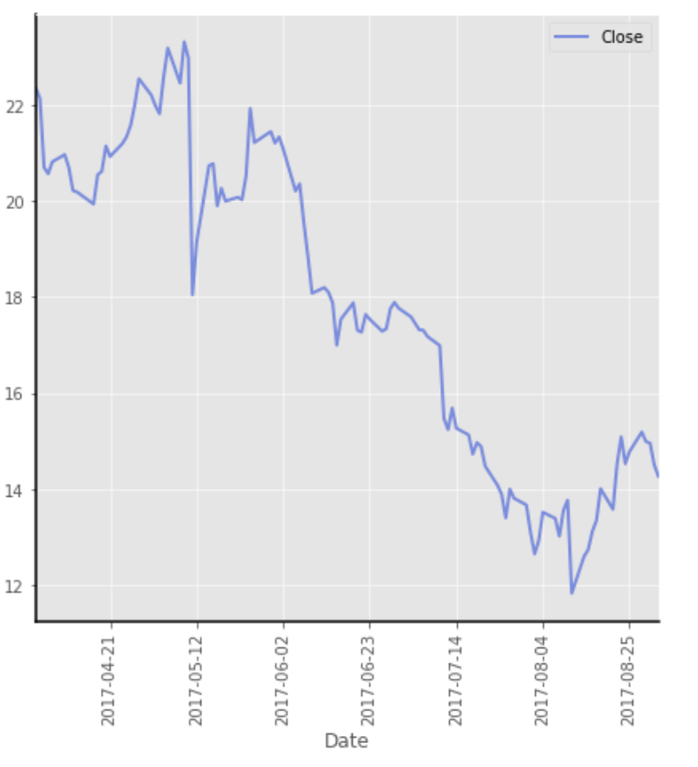
Hex Colors

Slide 19
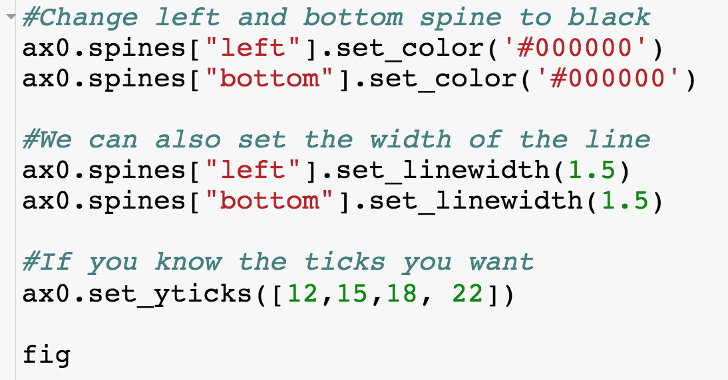
Customizing Axis Ticks
Input is list
There is also a xticks

Slide 20
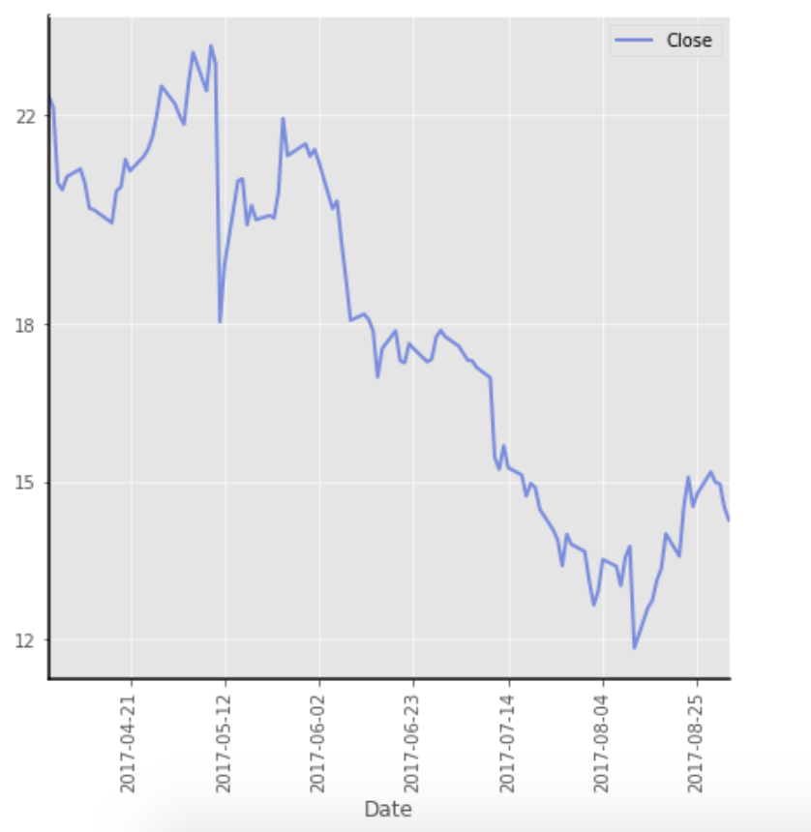
Customizing Axis Ticks

Slide 21
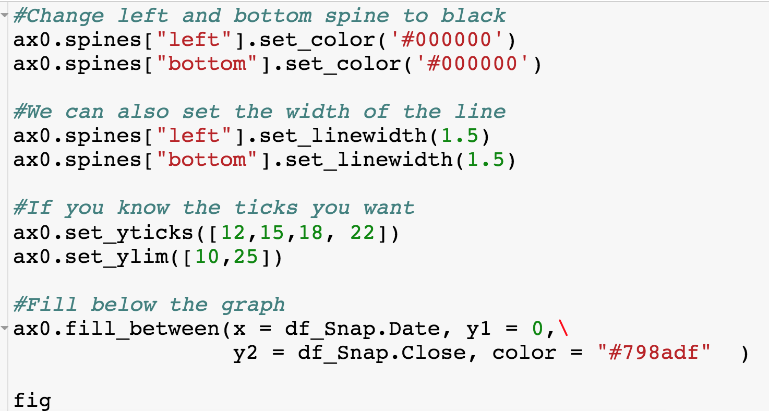
Filling the Graph
“Fill over over all dates from 0 to the closing price”

Slide 22
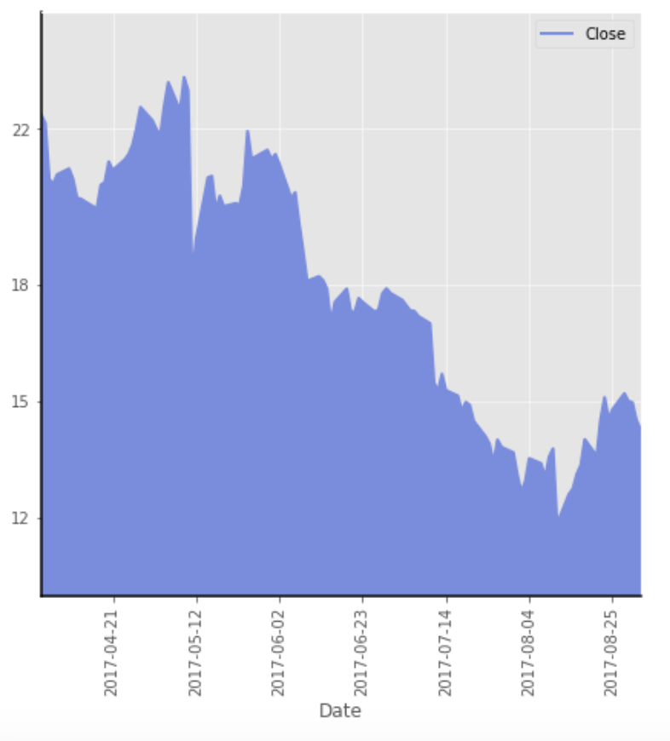
Filling the Graph

Slide 23
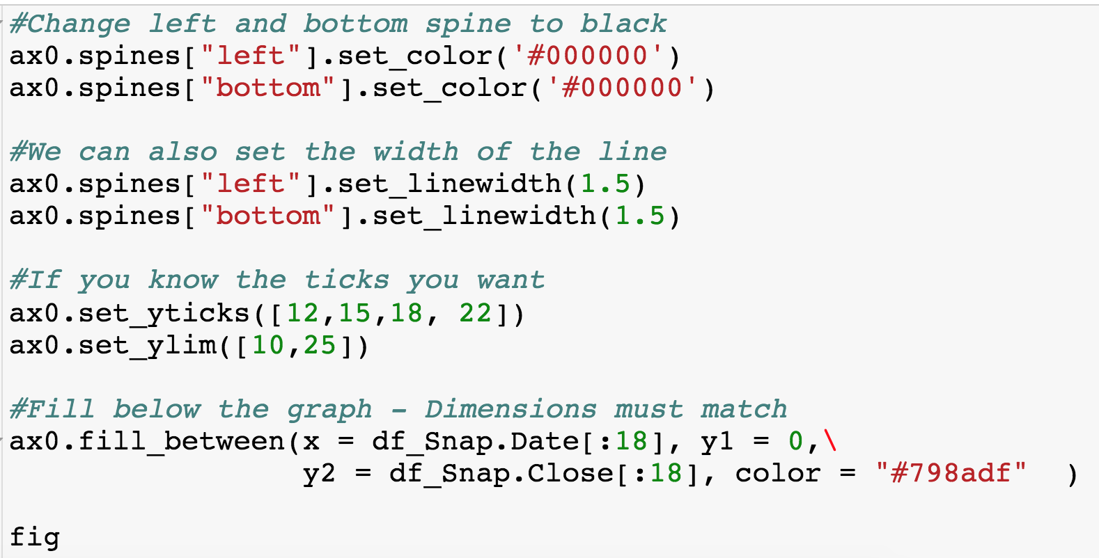
Filling the Graph – Change x

Slide 24
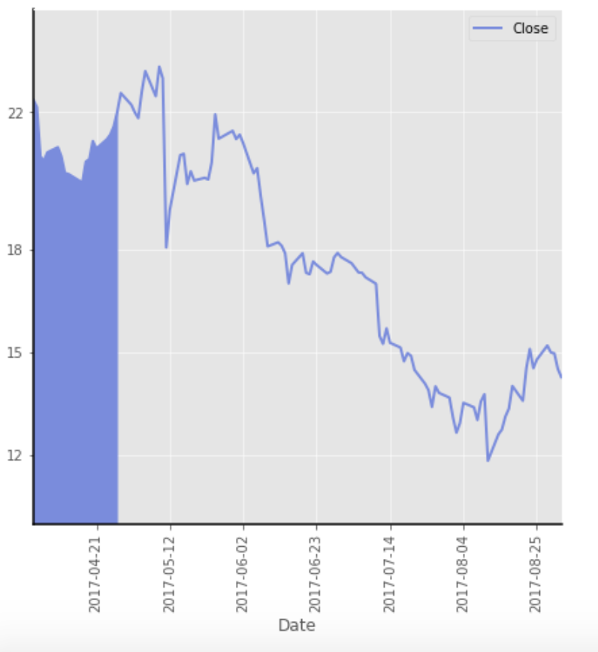
Filling the Graph – Change x

Slide 25
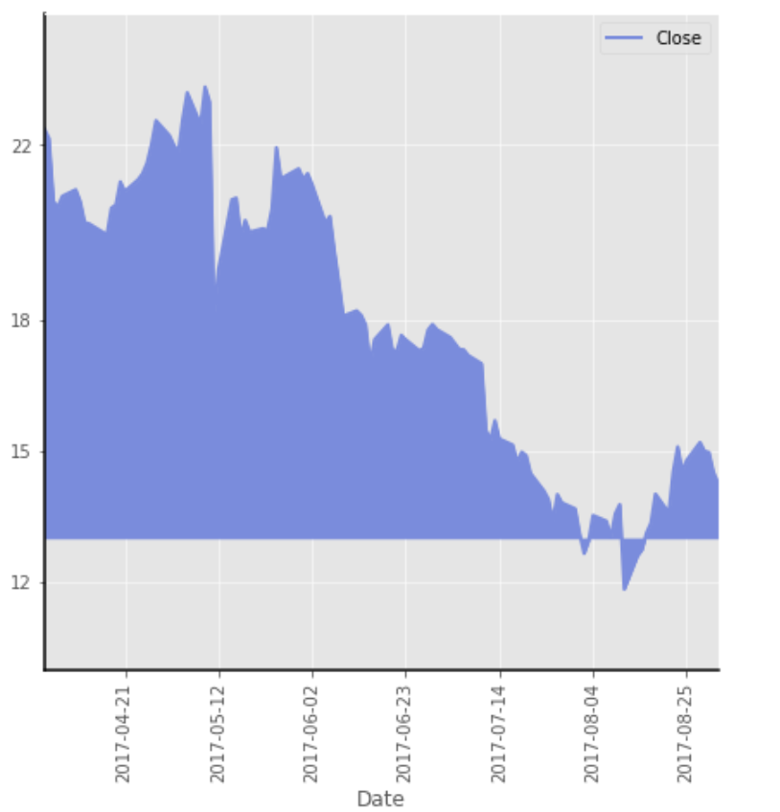
Filling the Graph – Change y
Let’s say we bought at 13

Slide 26
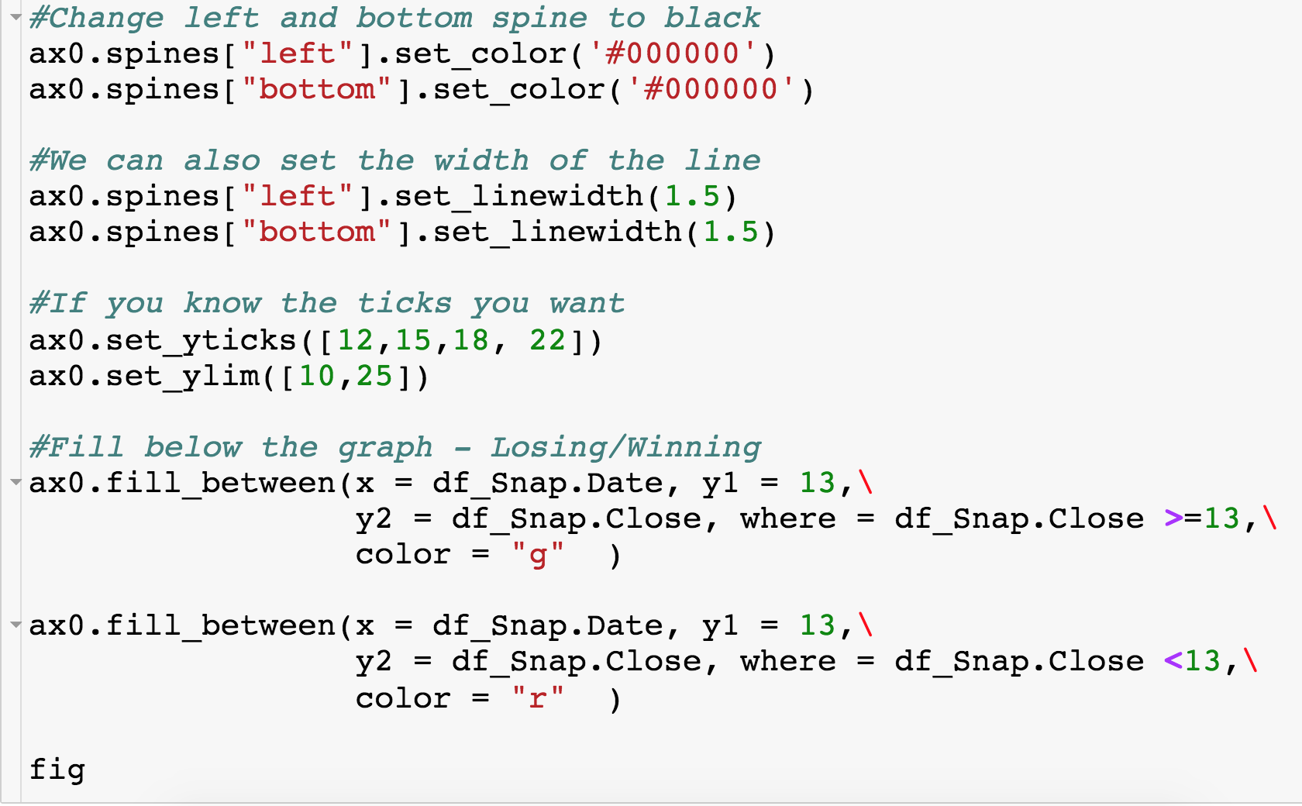
Filling the Graph – Where
Only color in areas where the “where” statement is satisfied

Slide 27
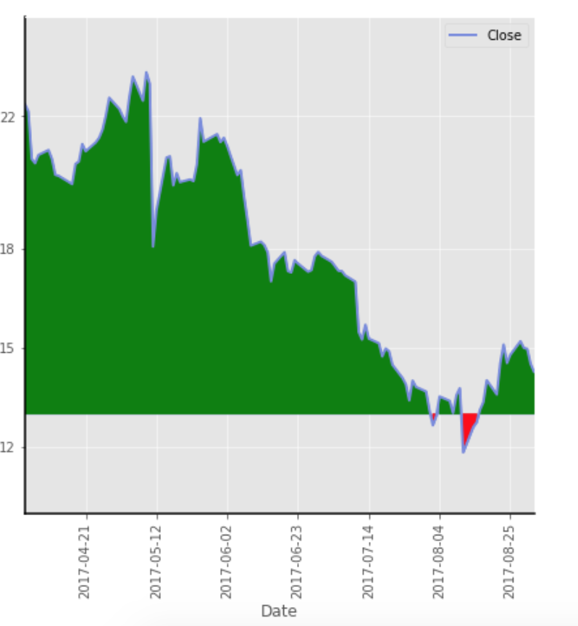
Filling the Graph – Where

Slide 28
Filling the Graph – alpha
Will make fill transparent

Slide 29
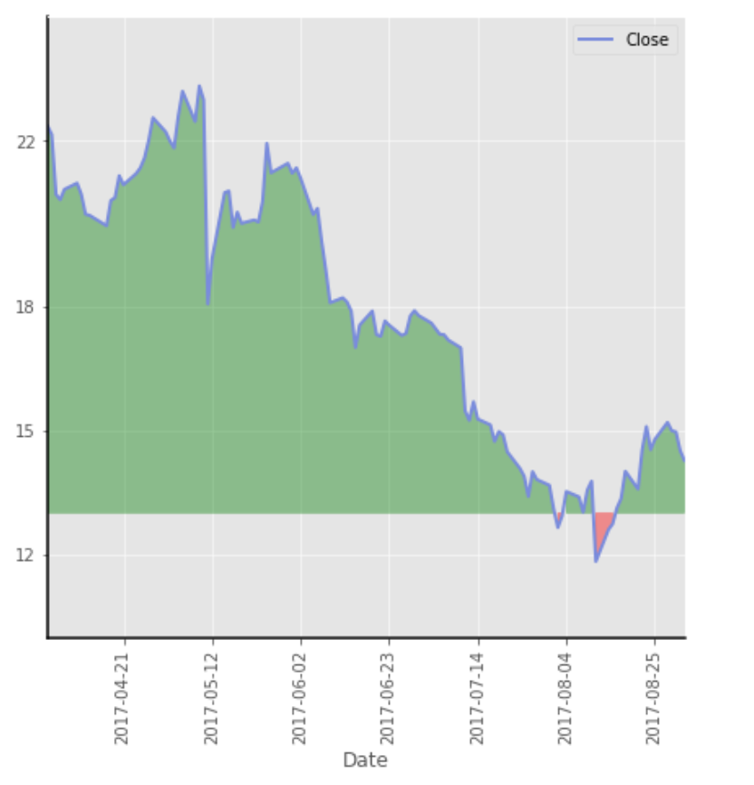
Filling the Graph – alpha

Slide 30
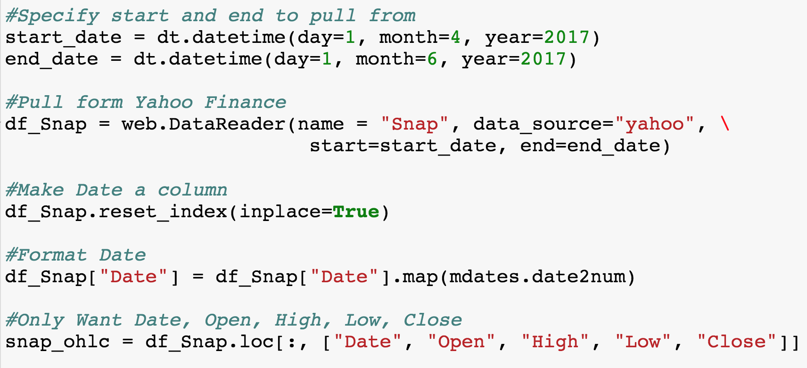
Candlestick Plot

Slide 31
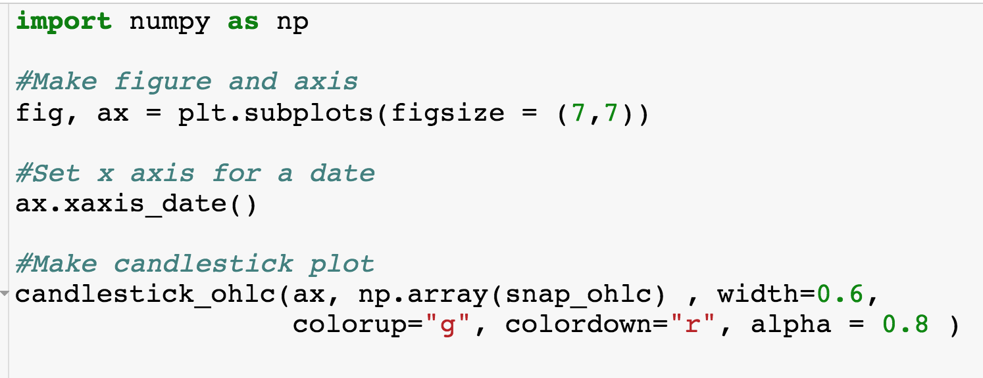
Candlestick Plot
Data needs to be given as numpy array
If close >= open, then color the candlestick green

Slide 32
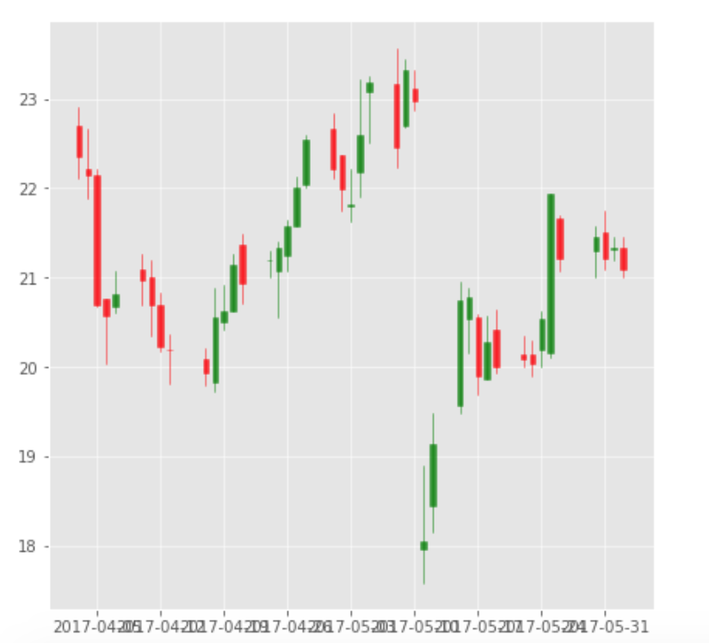
Candlestick Plot
x-axis needs to be tilted again

Slide 33
Candlestick Plot
x-axis needs to be tilted again

Slide 34
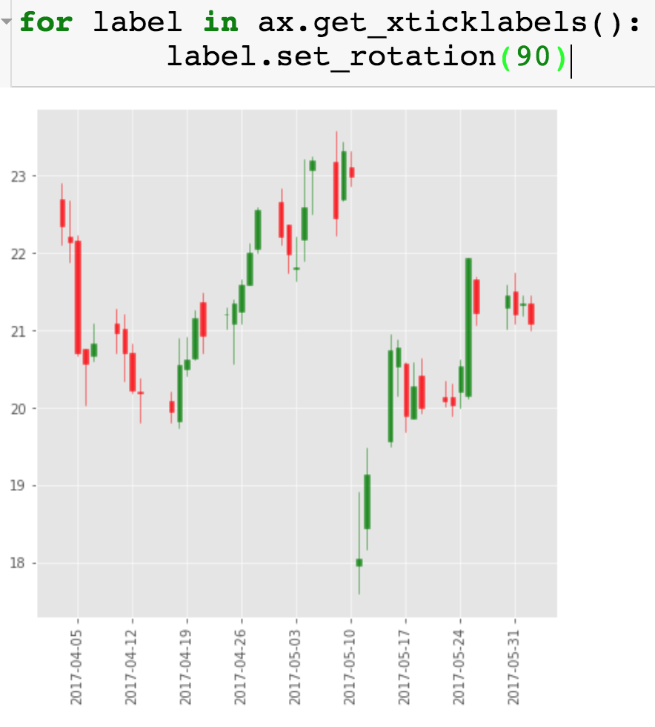
Candlestick Plot

