Slide 1
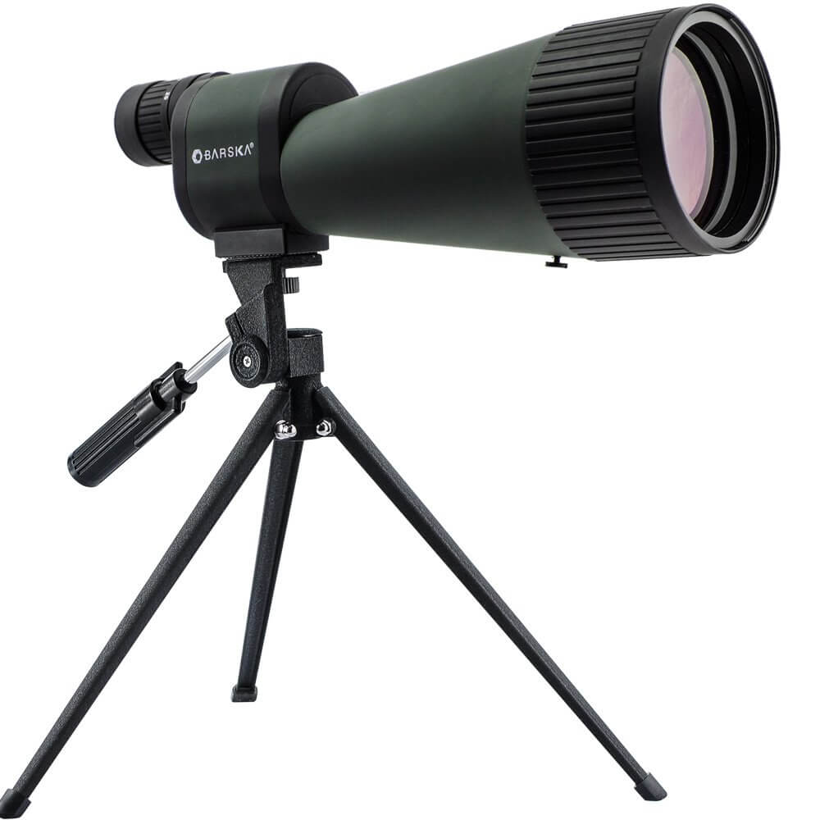
Functions + Scope

Slide 2
Functions
Why functions?
Maximize code reuse and minimize redundancy
Procedural decomposition
  Break bit task into smaller tasks
  Makes code less buggy – can test each function individually

Slide 3
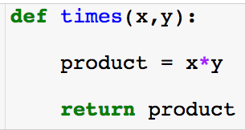
Functions
Create function (required)
Function inputs: here there are two and order matters. (optional)
Object that function gives back. (optional)

Slide 4
Functions
Create function (required)
Function inputs: here there are two and order matters. (optional)
Inside the function (local scope)
Object that function gives back. (optional)
The code inside the function is never executed unless you call the function!

Slide 5
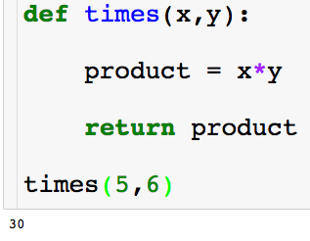
Functions
To call a function type the name and give the inputs required.

Slide 6
Functions
To call a function type the name and give the inputs required.

Slide 7
Functions
To call a function type the name and give the inputs required.

Slide 8
Functions
To call a function type the name and give the inputs required.

Slide 9
Functions
To call a function type the name and give the inputs required.

Slide 10
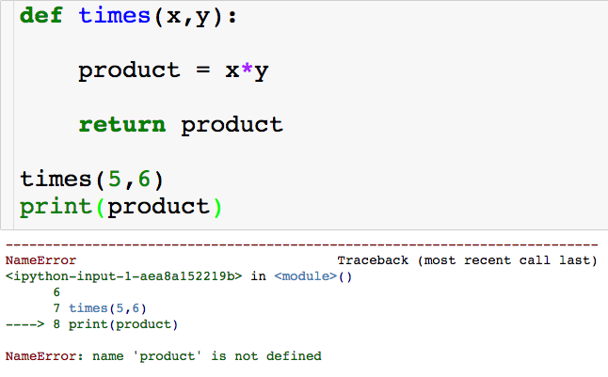
Functions
The variables product doesn’t exist outside of the function…but we can store the object returned by the function!

Slide 11
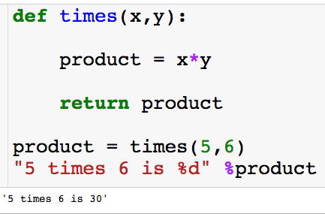
Functions
We can store the result returned from the function in a variables

Slide 12
Functions
We can store the result returned from the function in a variables

Slide 13
Functions
We can store the result returned from the function in a variables

Slide 14
Functions
We can store the result returned from the function in a variables

Slide 15
Functions
We can store the result returned from the function in a variables
We did not have to name this variable product, we could have names it anything.

Slide 16
Functions
We can store the result returned from the function in a variables

Slide 17
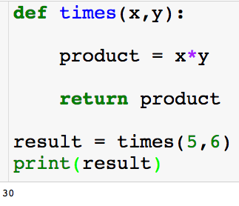
Functions
We can store the result returned from the function in a variables

Slide 18
Functions
We can store the result returned from the function in a variables
What will happen if I try to print product? Or x?

Slide 19
Functions
We can store the result returned from the function in a variables
What will happen if I try to print product? Or x?
Where does each variables “live”?

Slide 20
Scope
Python scopes are the places where variables are defined and looked up.
Local Scope
  Variables created with a function, i.e., inside of a def.
  Variables inside of a def will not clash with variables outside even if they have the same name.
Global Scope
  Variable created outside of a function.

Slide 21
Scope
Python scopes are the places where variables are defined and looked up.
Local Scope
  Variables created with a function, i.e., inside of a def.
  Variables inside of a def will not clash with variables outside even if they have the same name.
Global Scope
  Variable created outside of a function.
When outside of a function, python only sees variables in the global scope.

Slide 22
Scope
Python scopes are the places where variables are defined and looked up.
Local Scope
  Variables created with a function, i.e., inside of a def.
  Variables inside of a def will not clash with variables outside even if they have the same name.
Global Scope
  Variable created outside of a function.
When inside of a function, python first searches the local scope and then searches the global.

Slide 23
Scope
Local scope:
Global scope:

Slide 24
Scope
Local scope:
Global scope:

Slide 25
Scope
Local scope:
Global scope:

Slide 26
Scope
Local scope:
Global scope:

Slide 27
Scope
Local scope:
Global scope:

Slide 28
Scope
Local scope:
Global scope:

Slide 29
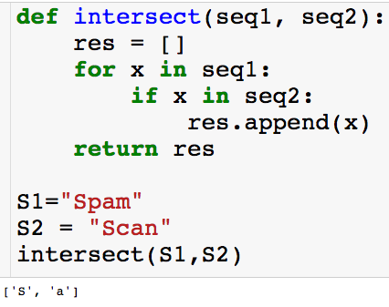
Scope
Local scope:
Global scope:

Slide 30
Scope
Local scope:
Global scope:

Slide 31
Scope
Local scope:
Global scope:

Slide 32
Scope
Local scope:
Global scope:

Slide 33
Scope
Local scope:
Global scope:

Slide 34
Scope
Local scope:
Global scope:

Slide 35
Scope
Local scope:
Global scope:

Slide 36
Scope
Local scope:
Global scope:

Slide 37
Scope
Local scope:
Global scope:

Slide 38
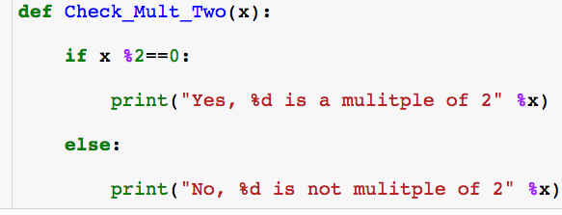

Stringing Functions Together

Slide 39
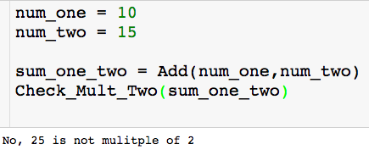
Stringing Functions Together

Slide 40
Stringing Functions Together

Slide 41
Stringing Functions Together

Slide 42
Stringing Functions Together

Slide 43
Stringing Functions Together

Slide 44
Stringing Functions Together

Slide 45
Stringing Functions Together

Slide 46
Stringing Functions Together

Slide 47
Nested Functions
Functions can call other functions!

Slide 48
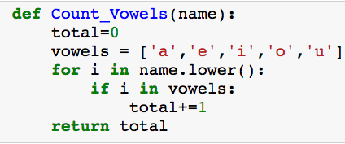
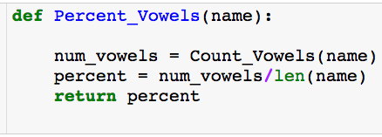
Nested Functions
Count number of vowels in name
Computes percentage of vowels in name

Slide 49

Nested Functions
Count number of vowels in name
Computes percentage of vowels in name

Slide 50
Nested Functions
Count number of vowels in name
Computes percentage of vowels in name

Slide 51
Nested Functions
Count number of vowels in name
Computes percentage of vowels in name

Slide 52
Nested Functions
Count number of vowels in name
Computes percentage of vowels in name

Slide 53
Nested Functions
Count number of vowels in name
Computes percentage of vowels in name

Slide 54
Nested Functions
Count number of vowels in name
Computes percentage of vowels in name

Slide 55
Nested Functions
Count number of vowels in name
Computes percentage of vowels in name

Slide 56
Nested Functions
Count number of vowels in name
Computes percentage of vowels in name

Slide 57

Nested Functions
Count number of vowels in name
Computes percentage of vowels in name

Slide 58
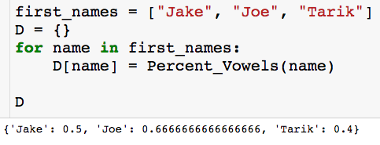
Nested Functions
Count number of vowels in name
Computes percentage of vowels in name

