Slide 1
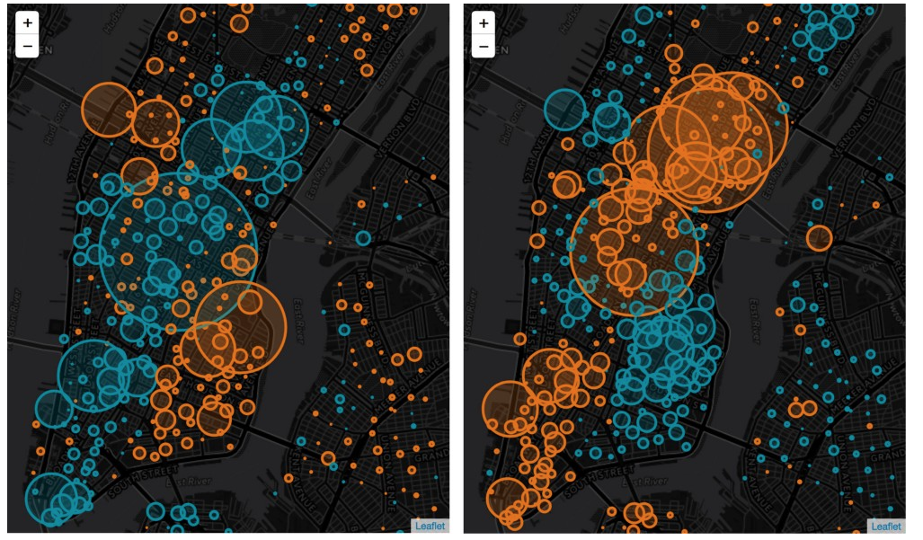
Plotting in Folium

Slide 2
Folium
Really powerful plotting software.
Place markers on map
Circles of varying sizes
Heatmaps
Slide bars
Animations
The list goes on….
To install folium package:

Slide 3
Creating Map
location: list of lat, long

Slide 4
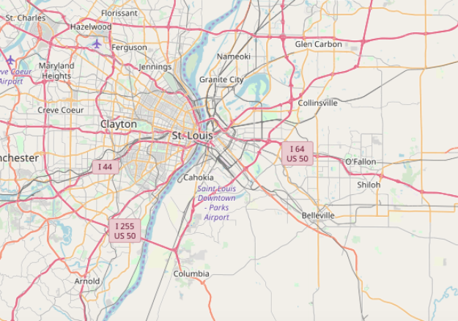
Creating Map
location: list of lat, long

Slide 5
Creating Map - Zoom
zoom_start: takes an integer (0-18)

Slide 6
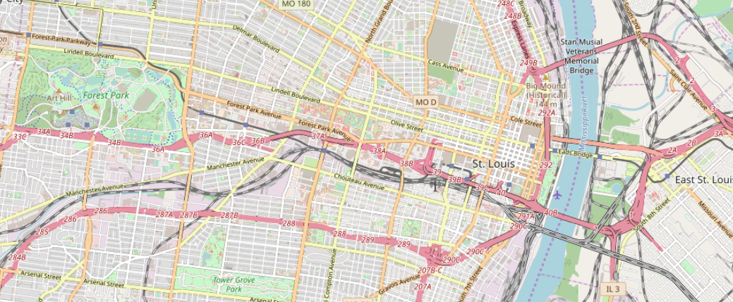
Creating Map - Zoom
zoom_start: takes an integer (0-18)

Slide 7
Creating Map - Style
tiles: Stamen Terrain, Stamen Toner, CartoDB dark_matter (title slide)

Slide 8
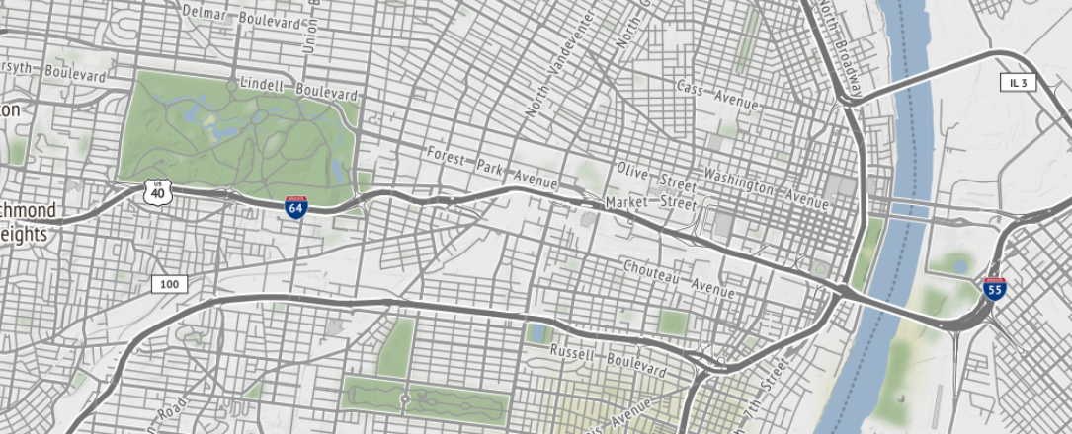
Creating Map - Style
tiles: Stamen Terrain, Stamen Toner, CartoDB dark_matter (title slide)

Slide 9
Creating Map – Add Marker

Slide 10
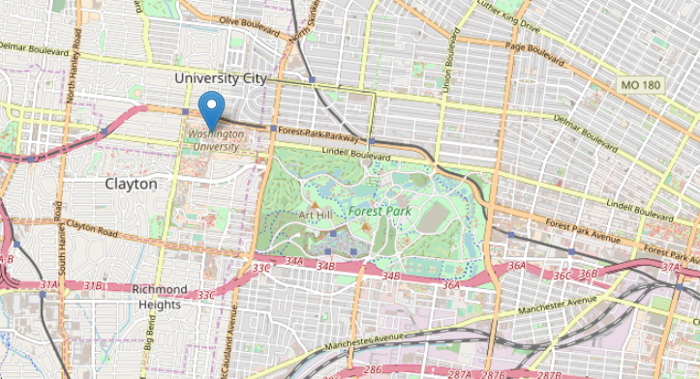
Creating Map – Add Marker

Slide 11
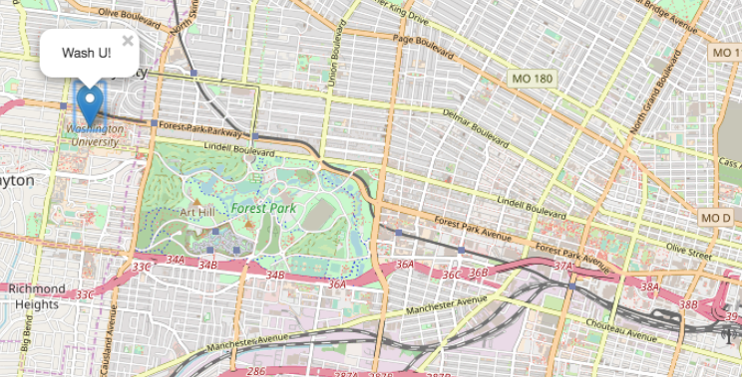
Creating Map – Add Marker
popup: string that will appear when marker is clicked

Slide 12
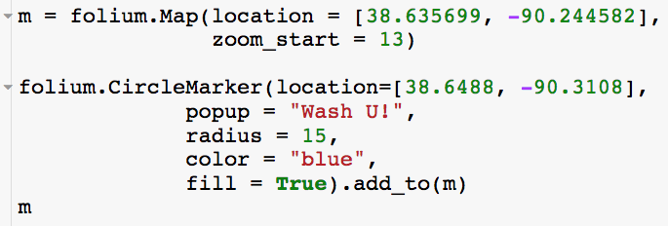
Creating Map – Add Circle Marker
radius: float that controls
size of circle
fill: Boolean indicating whether or not to color in circle

Slide 13
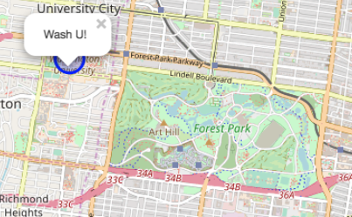
Creating Map – Add Circle Marker
radius: float that controls
size of circle
fill: Boolean indicating whether or not to color in circle

Slide 14
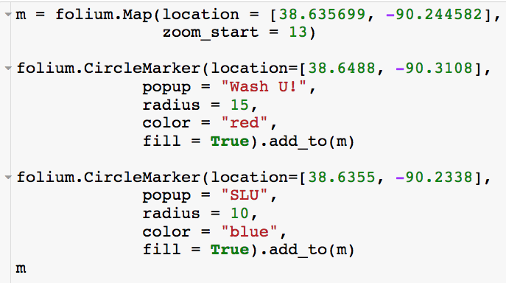
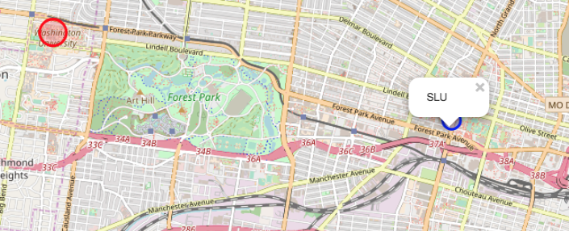
Creating Map – Add Circle Marker

Slide 15
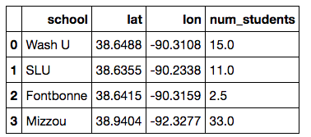
Creating Map – Adding Multiple Markers
Use for loop to go over each school and create plot!

Slide 16
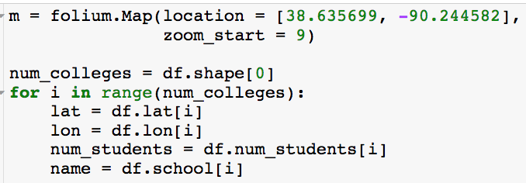
Creating Map – Adding Multiple Markers

Slide 17
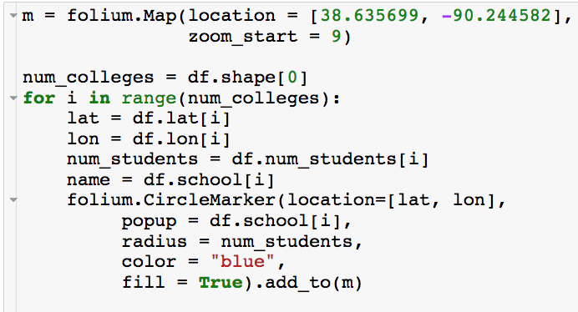
Creating Map – Adding Multiple Markers

Slide 18
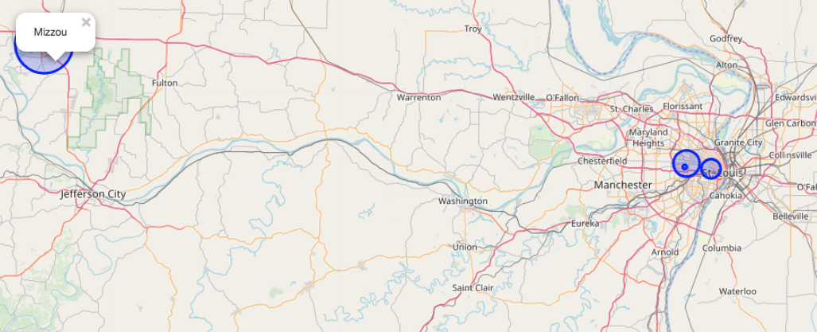
Creating Map – Adding Multiple Markers

Slide 19
Creating Map – Color Scales
colors: list of colors

Slide 20
Creating Map – Color Scales
colors: list of colors

Slide 21
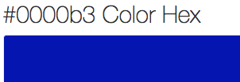
Creating Map – Color Scales
colors: list of colors

Slide 22
Creating Map – Color Scales
vmin: start of scale
vmax: end of scale

Slide 23
Creating Map – Color Scales
vmin: start of scale
vmax: end of scale
index: list that must have same length as colors. Controls where in scale each color starts

Slide 24
Creating Map – Color Scales
vmin: start of scale
vmax: end of scale

Slide 25
Creating Map – Color Scales
Now lets say I want to add color scale as well

Slide 26
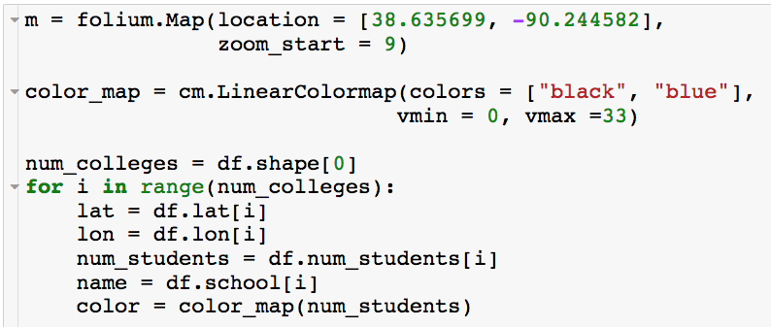
Creating Map – Color Scales

Slide 27
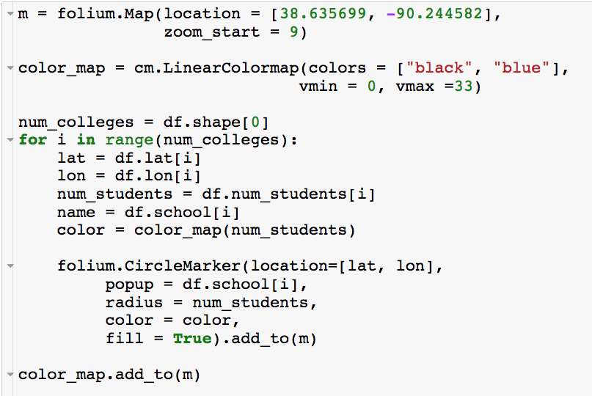
Creating Map – Color Scales
colors: list of colors
Adds color scale as legend

Slide 28
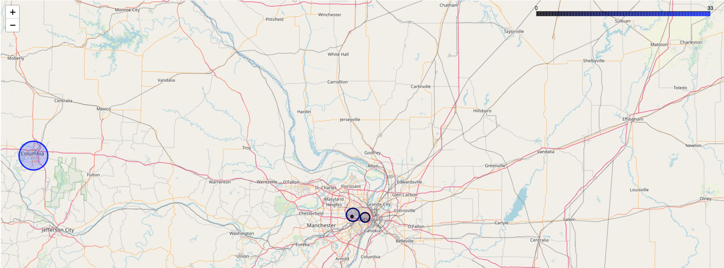
Creating Map – Color Scales

Slide 29
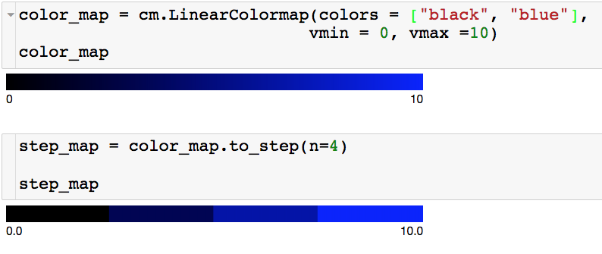
Creating Map – Color Scales Steps
n: number of colors

Slide 30
Creating Map – Color Scales Steps

Slide 31
Creating Map – Color Scales Steps
data: give column you want scale to be based on. This will automatically change the range of the color map

Slide 32
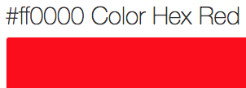
Creating Map – Color Scales Steps
data: give column you want scale to be based on. This will automatically change the range of the color map

Slide 33
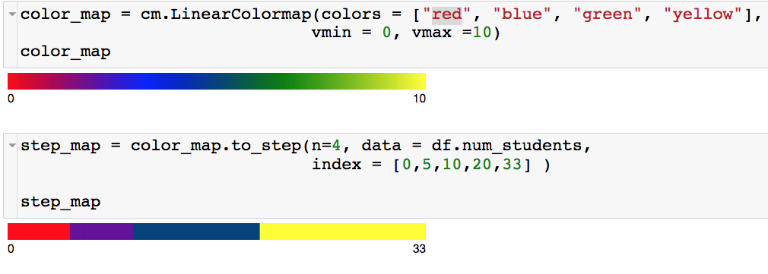
Creating Map – Color Scales Steps
index: list of break points (length n+1) for color map.

Slide 34
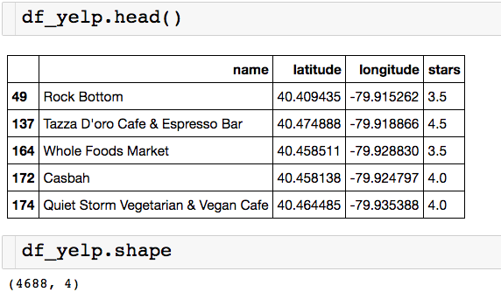
Creating Map – Color Scales Steps
Let’s plot the five star values in 5 different values

Slide 35
Creating Map – Color Scales Steps

Slide 36
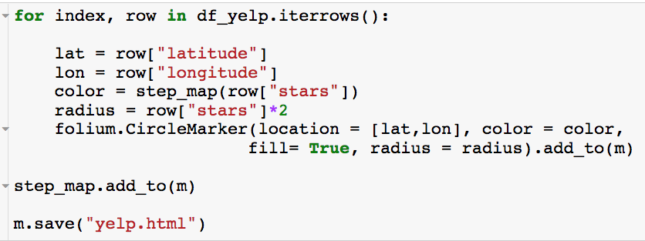
Creating Map – Color Scales Steps

Slide 37
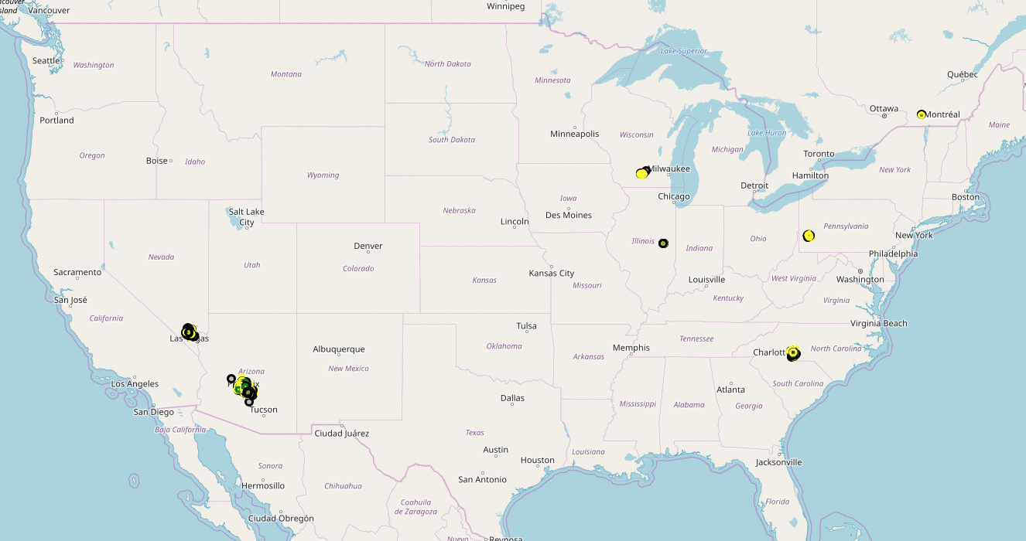
Creating Map – Color Scales Steps

Slide 38
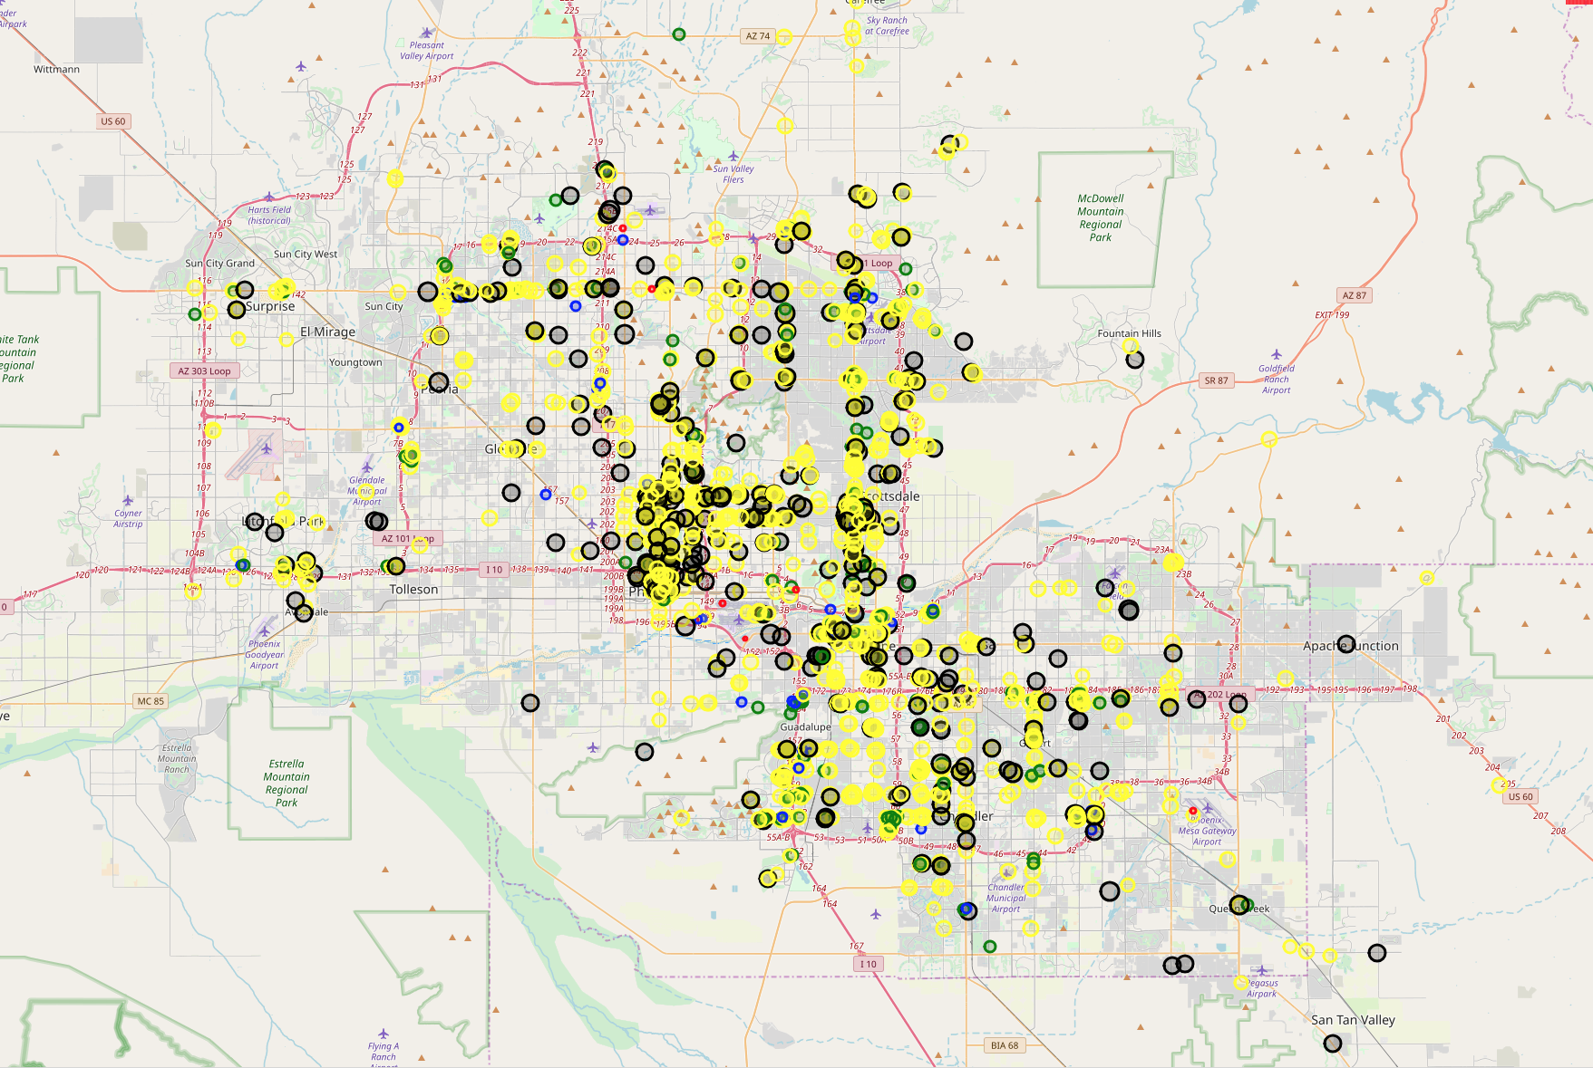
Creating Map – Color Scales Steps
Zoomed into Scottsdale, AZ

