Slide 1
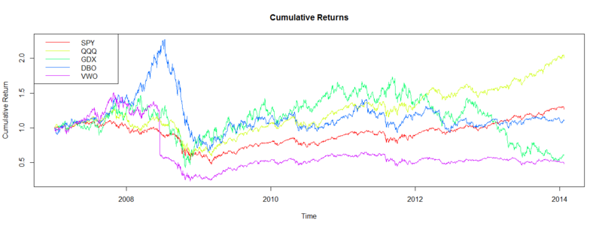
Time Series Window Functions

Slide 2
Moving Window Functions
Apply statistics or other functions to sliding window or exponentially decaying weights.
Automatically exclude missing data
Rolling means, medians, max, correlations
Exponentially weighted moving averages
Pandas ts objects are equipped with rolling method, which is the main function most of the moving window functions.

Slide 3
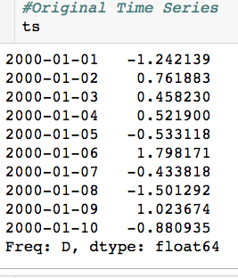
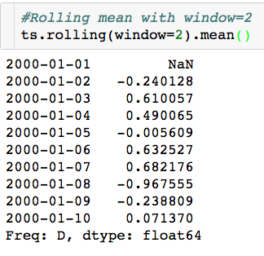
Moving Window Functions

Slide 4
Moving Window Functions
Why is there an NaN?

Slide 5
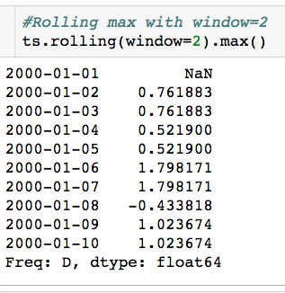
Moving Window Functions

Slide 6
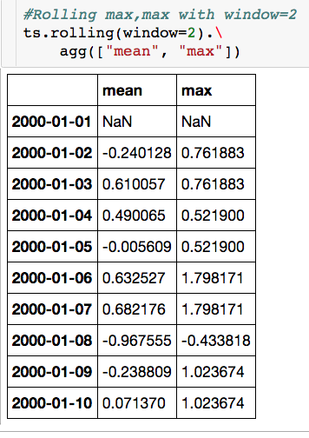
Moving Window Functions

Slide 7
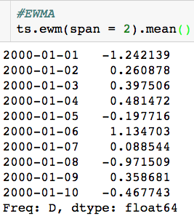
Moving Window Functions
Span = window length

