Slide 1
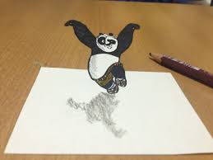
Plotting in Pandas/Matplotlib

Slide 2
Plotting in Pandas
We will start by seeing how to make basic plots in pandas from data stored in a pandas dataframe.
We will then see how to add the following features to our graphs:
Change titles/axis titles
Annotate the graph
Change the window of the graph
Customizing axis labels
Create multiple plots
In a future lecture, we will then investigate more advanced plotting tools.

Slide 3
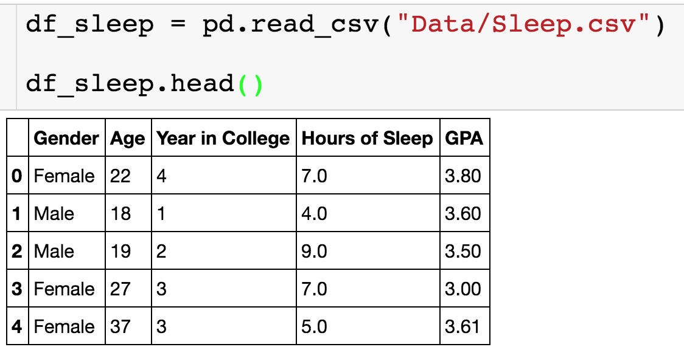
Sleep Data
We have the following data on how hours of sleep is related to GPA.

Slide 4
Basic Scatterplot
Makes plot show in Jupyter notebook
Type of plot given as string
Given x,y axis

Slide 5
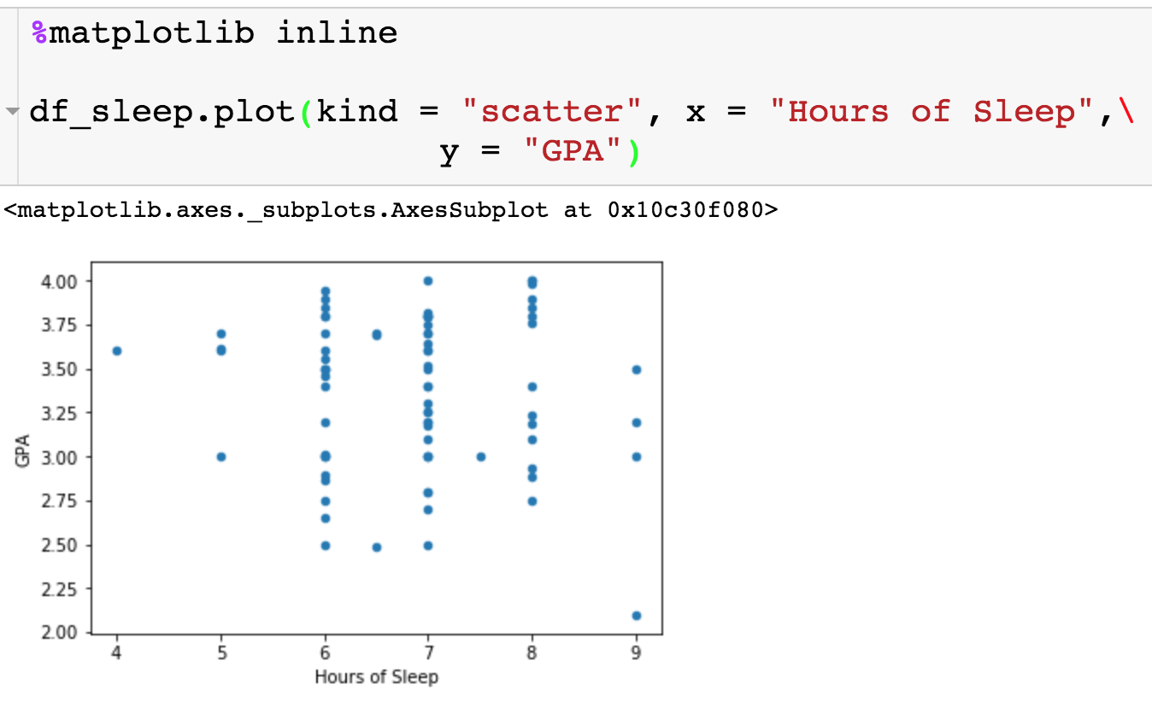
Basic Scatterplot
No title
Axis labels are column names

Slide 6
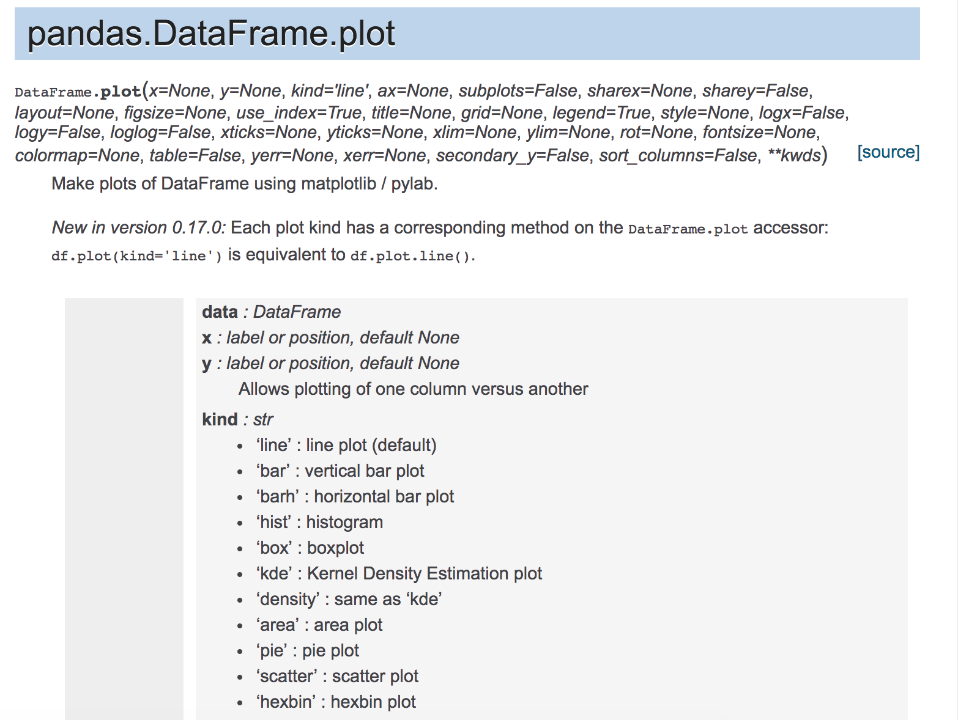
Other Types of Plots

Slide 7
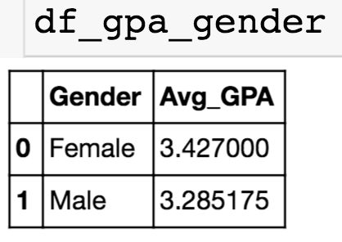
Basic Barplot
I have computed the average GPA for each. I will show you later on how to do this.

Slide 8
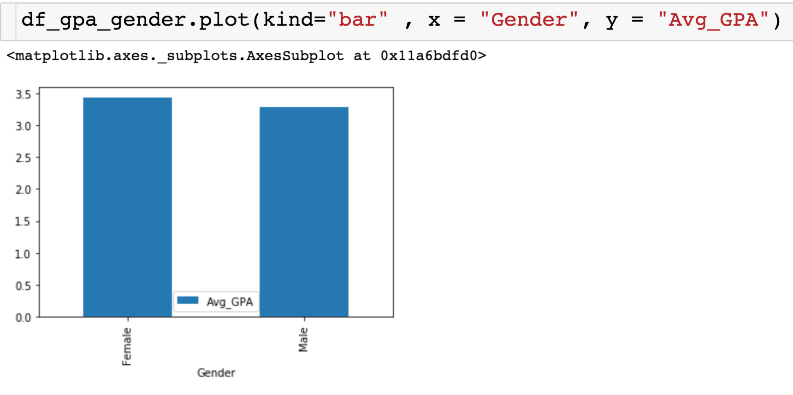
Basic Barplot

Slide 9
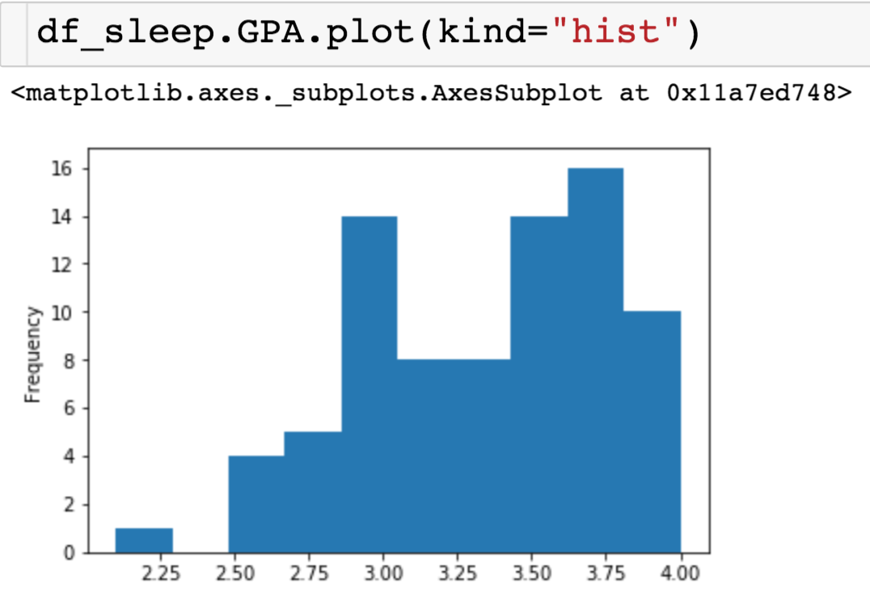
Basic Histogram

Slide 10
Basic Histogram
Number of bins to use

Slide 11
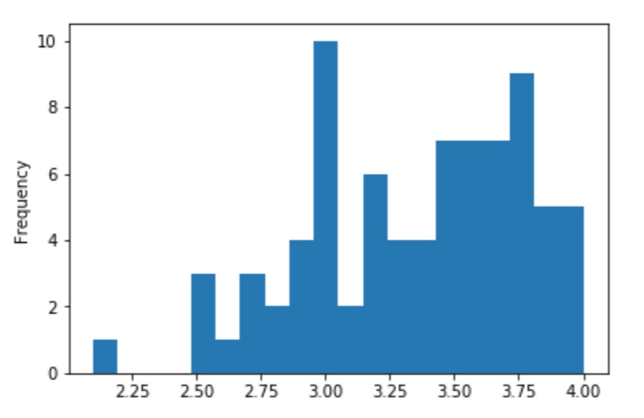
Basic Histogram

Slide 12
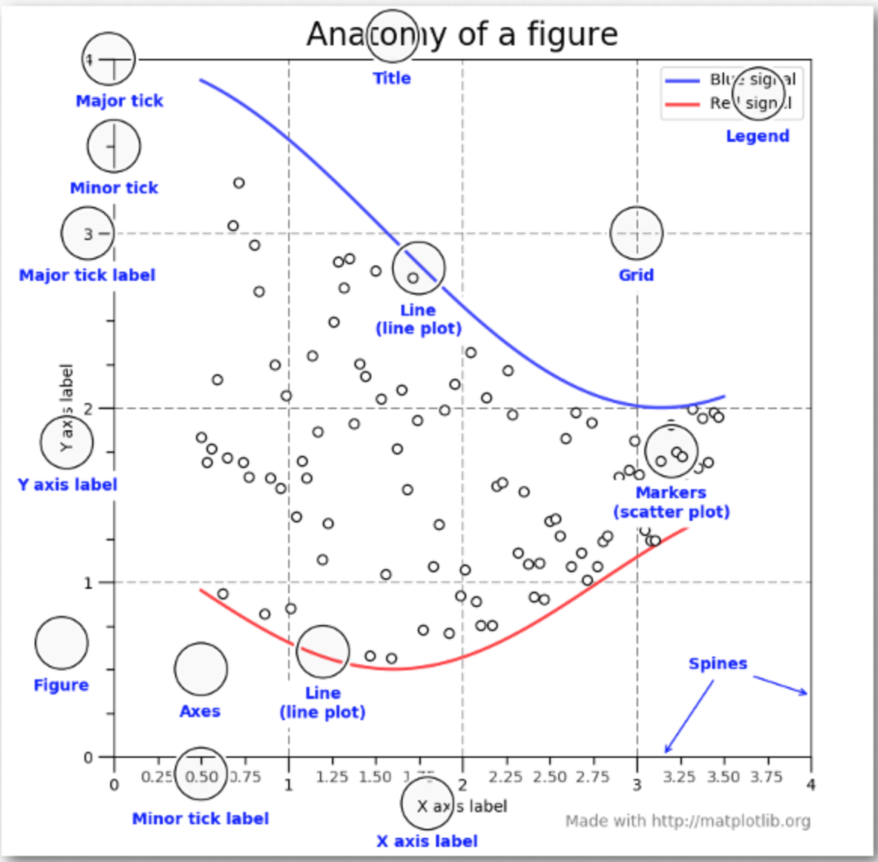
Customizing the Plots

Slide 13
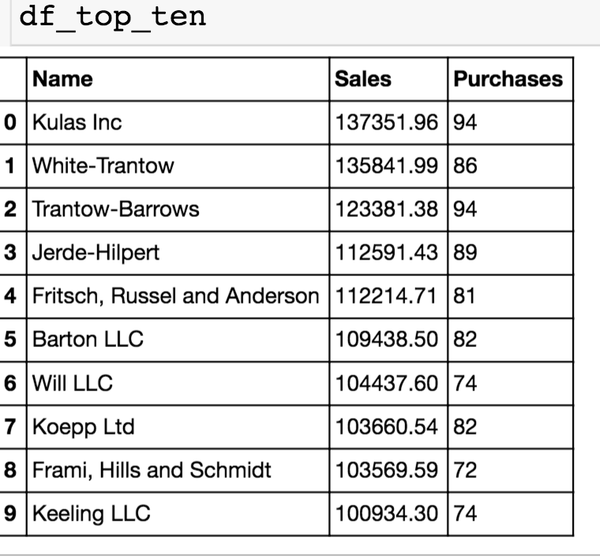
Sales Data
Consider the data from the top 10 customers:

Slide 14
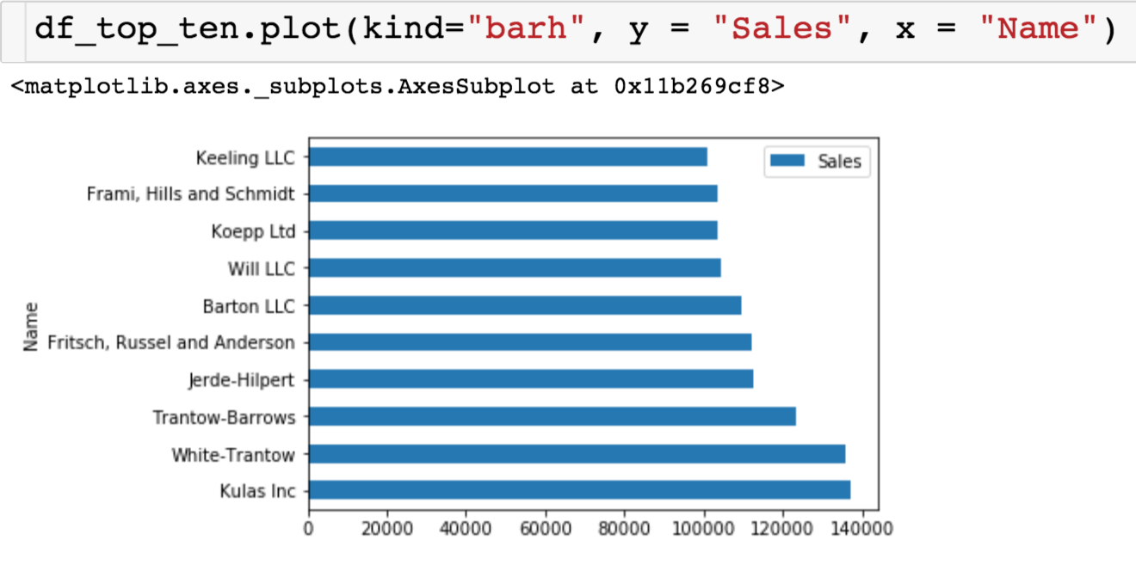
Sales Data
Let’s use pandas to create a basic bar plot and then see how we can manipulate it with matplotlib.

Slide 15
Matplotlib
We need the following import statement when we want to use matplotlib
We can use matplotlib to change the styling of our plots:
We can change the style as follows:

Slide 16
Creating Figure and Axes

Slide 17
Creating Figure + Axis
You will place something like this line of code before every plot that you create. Creates the following to elements of the visualization you want to produce:
The variable fig will be the figure, which represents the entire visualization. A figure could contain multiple plots.
Adjust size
Number of plots
Boarders
The variable ax represents the axes of a single plot
Change axis limit/labels/ticks
Add multiple plots
Change titles

Slide 18
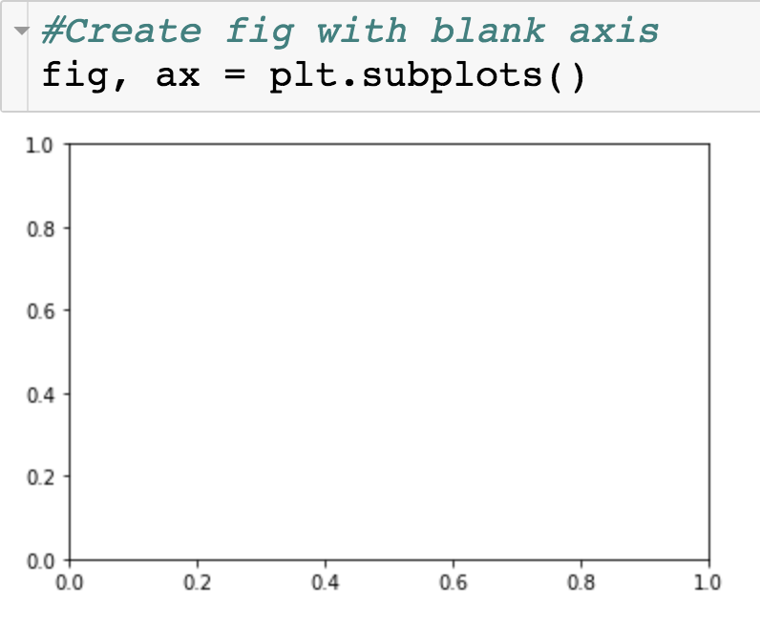
Creating Figure + Axis

Slide 19
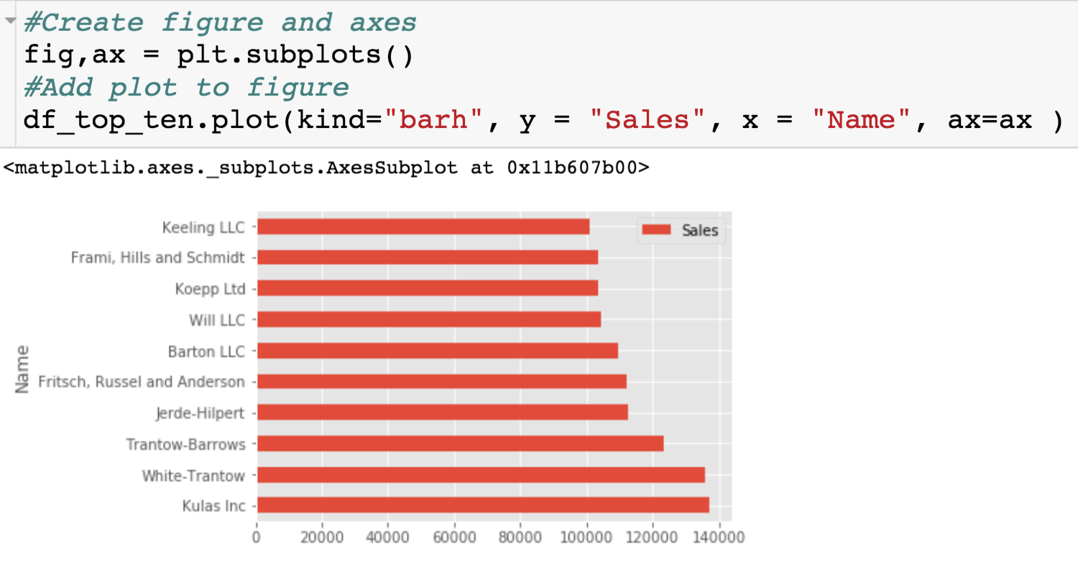
Adding Barplot to Figure
Same plot, but now we can change the plot using attributes of the variables fig and ax.

Slide 20
Changing Features of Axes

Slide 21
Changing Features of Axes
The variable that stores our axes
List of x limits

Slide 22
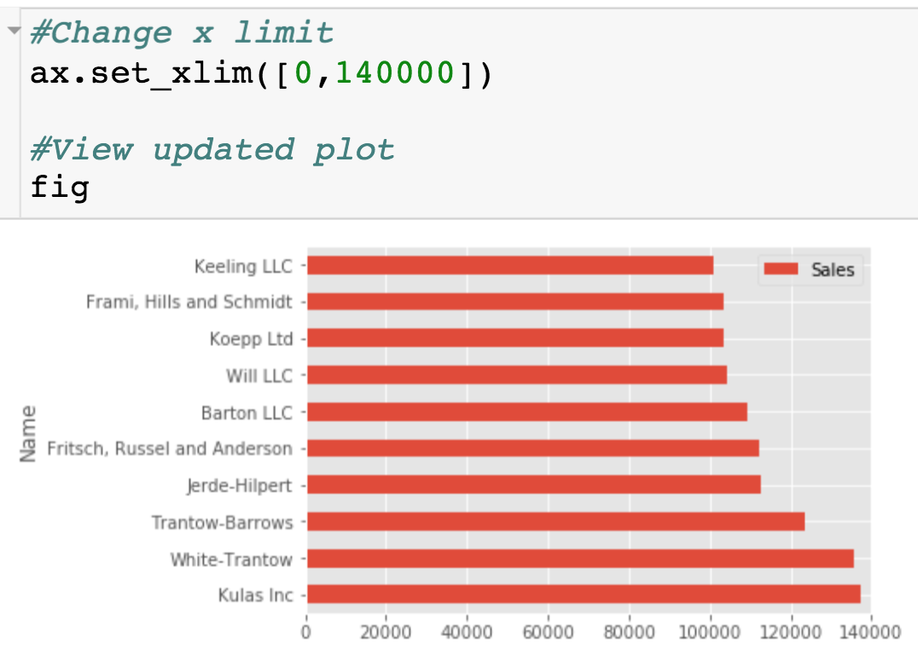
Changing Features of Axes
x-axis only goes up to 140000

Slide 23
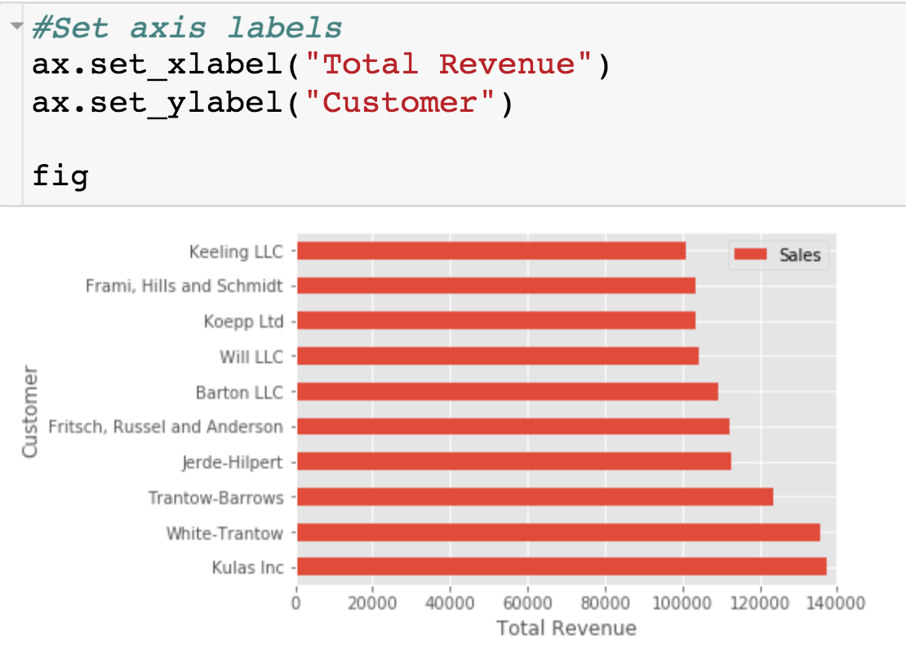
Changing Features of Axes
New axis labels

Slide 24
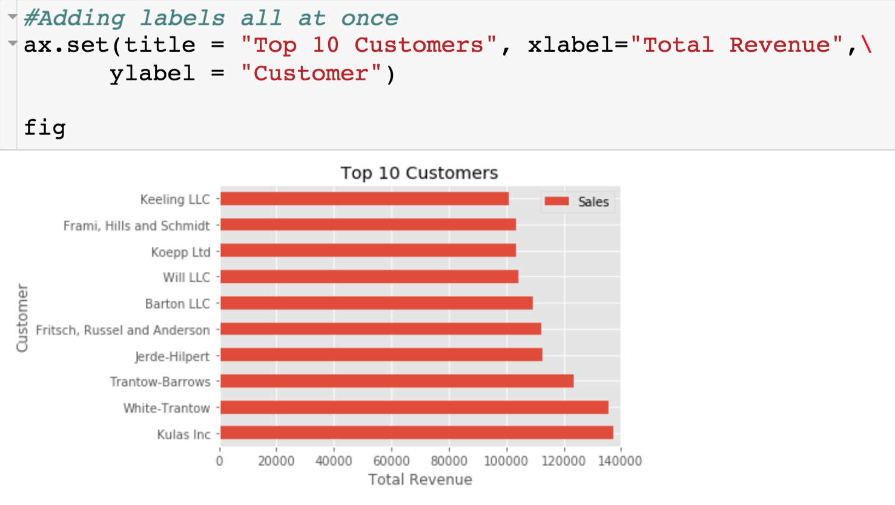
Changing Features of Axes
Title

Slide 25
Change Figure Size
Give list of length of length and width in inches

Slide 26
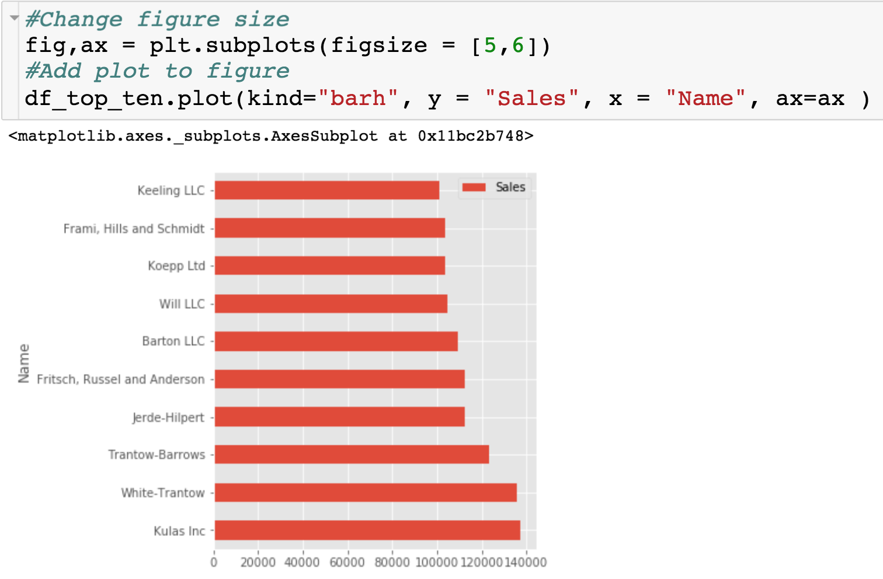
Change Figure Size

Slide 27
Move Legend

Slide 28
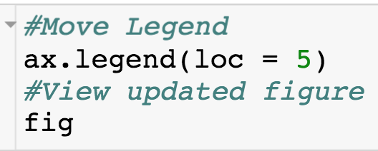
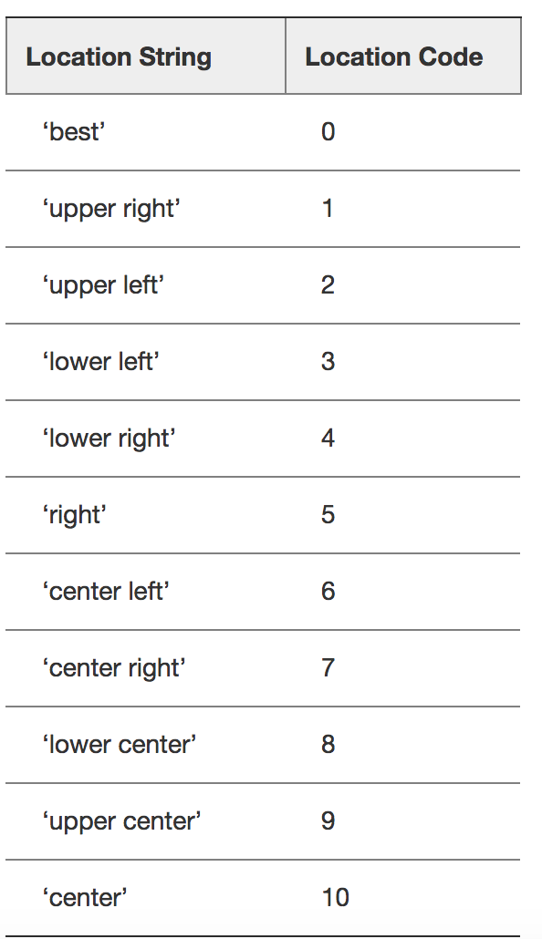
Move Legend
loc parameter moves legend

Slide 29
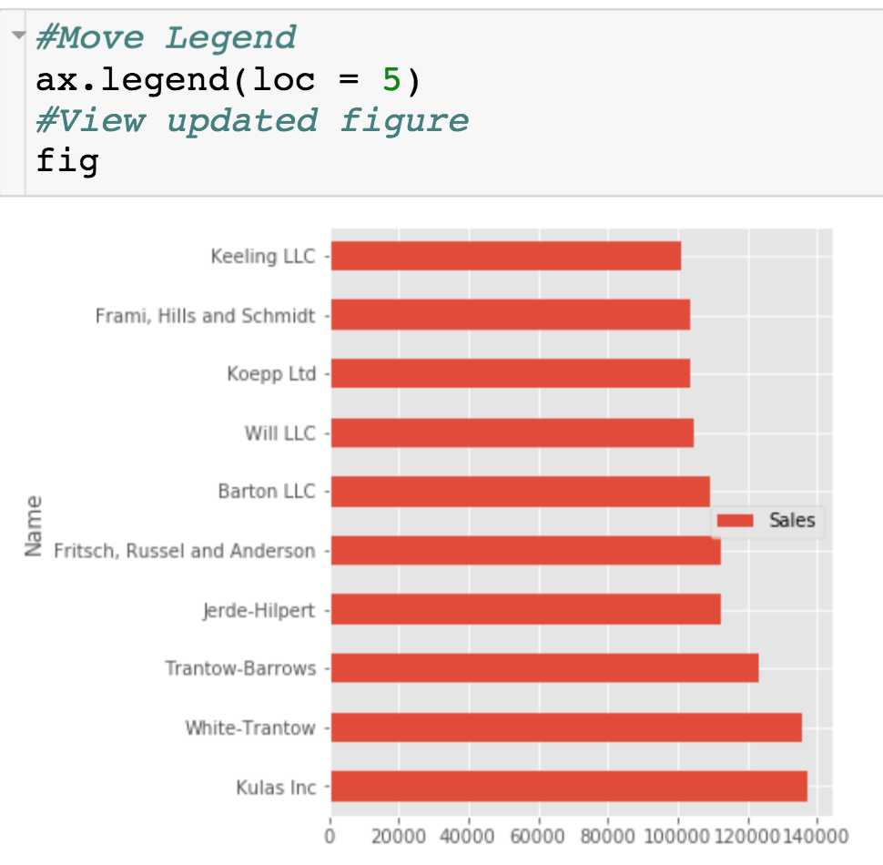
Move Legend
New legend placement

Slide 30
Move Legend
New legend placement

Slide 31
Annotate the Plot – Vertical Line
Where to draw vertical line
What do put in legend

Slide 32
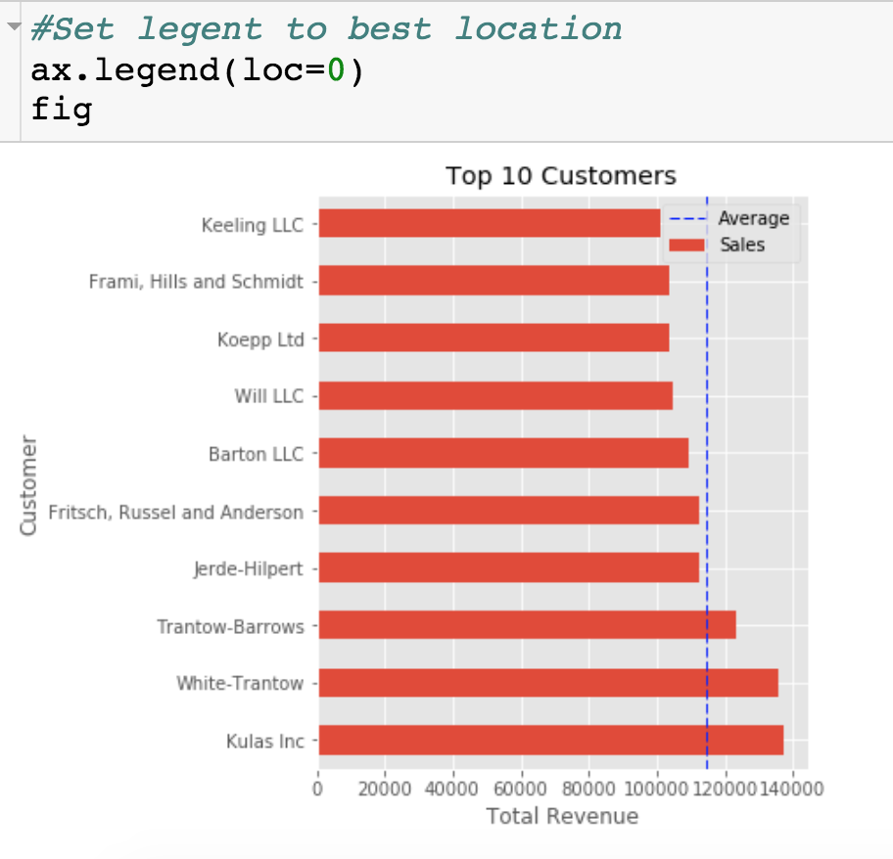
Annotate the Plot – Vertical Line

Slide 33
Annotate the Plot – Add Text
(x,y) for where to place text
Text to place

Slide 34
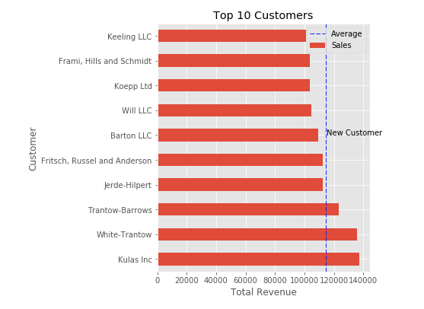
Annotate the Plot – Add Text

Slide 35
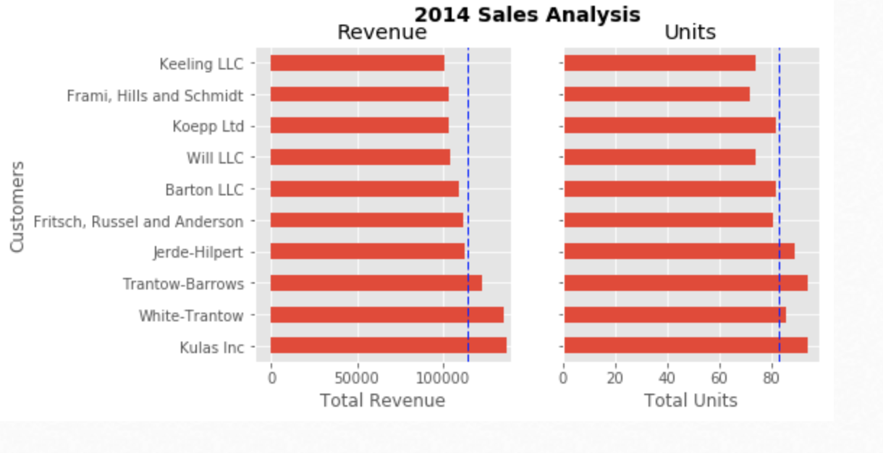
Creating Multiple Plots

Slide 36
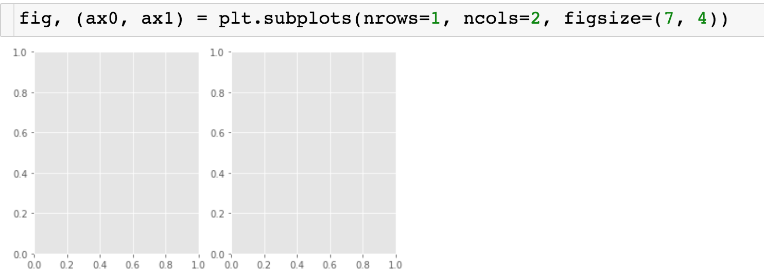
Creating Multiple Plots
7x4 Figure, with 1 row and 2 columns of subplots
ax1
ax0

Slide 37
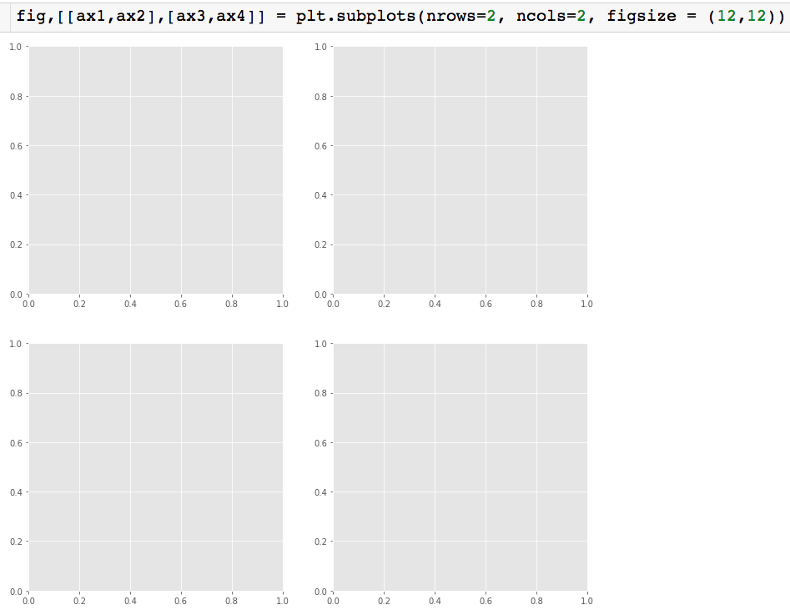
Creating Multiple Plots
List of lists
12x12 Figure, with 2 rows and 2 columns of subplots
ax1
ax2
ax3
ax4

Slide 38
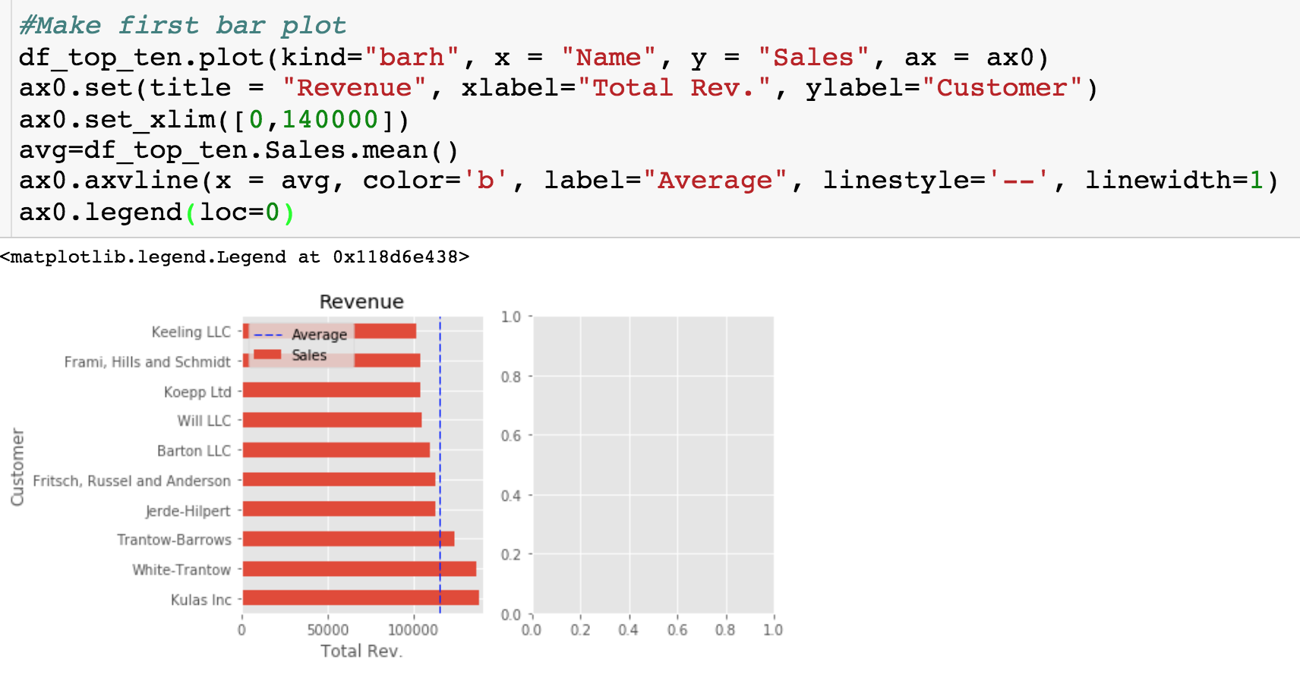
Creating Multiple Plots
Notice that all references are made to ax0.

Slide 39
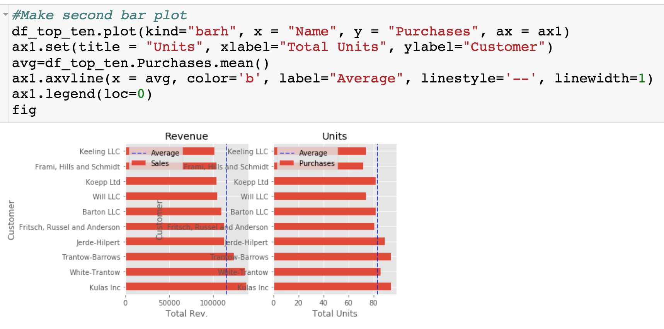
Creating Multiple Plots
Uh oh! Plots are overlapping. Let’s two options for fixing this.

Slide 40
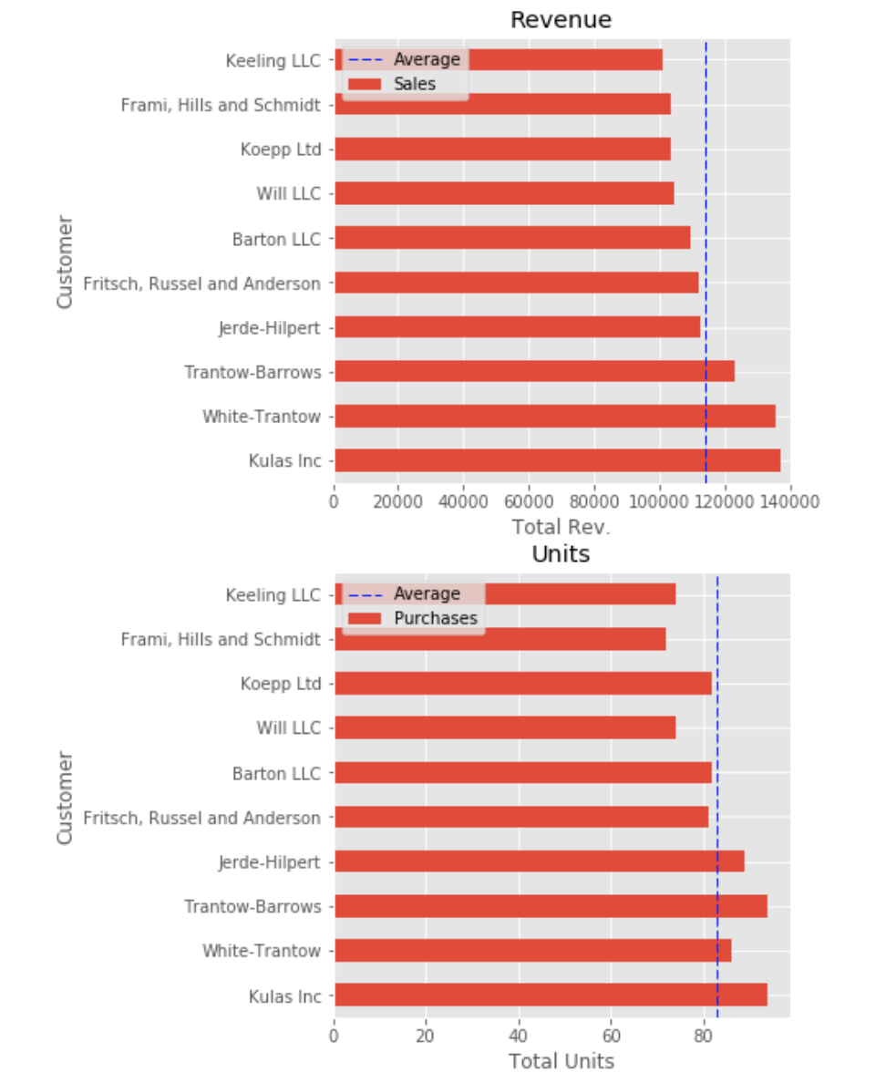
Creating Multiple Plots
updated

Slide 41
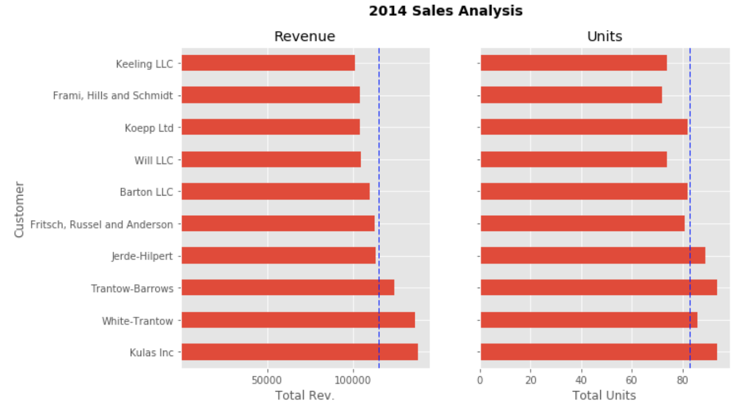
Creating Multiple Plots

Slide 42
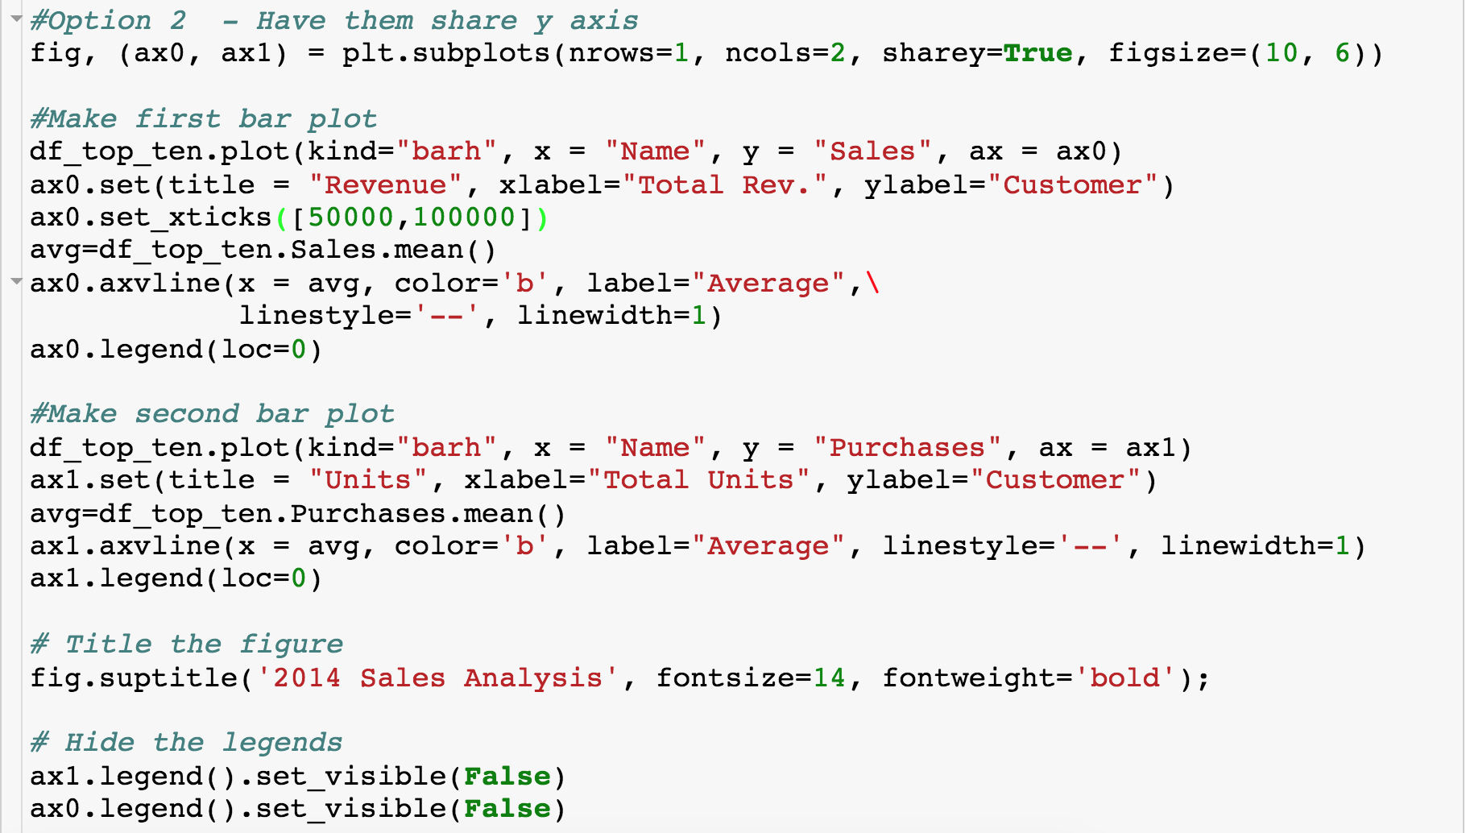
All of the Code

