Slide 1
Advanced Pandas – Part 2

Slide 3
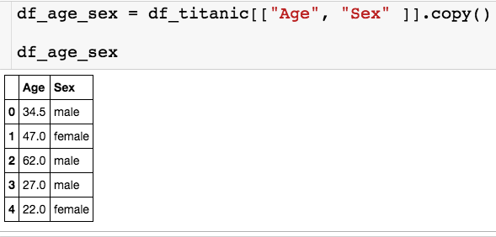
Using Apply
Let’s see how we can use apply with a custom function on a single column:
Let’s use apply to create a binary column that is 1 if the passenger is male and 0 if female.

Slide 4
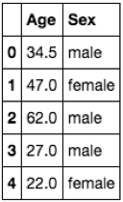
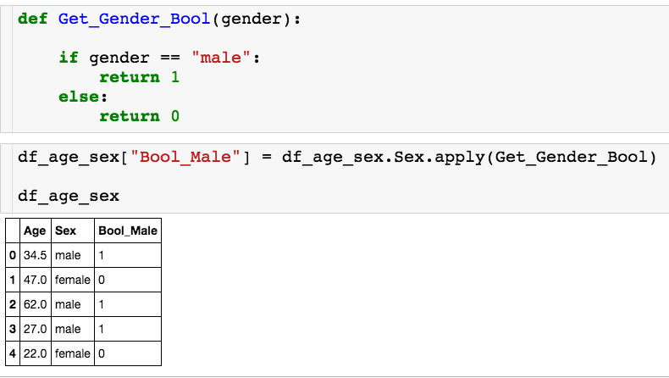
Using Apply
Let’s see how we can use apply with a custom function on a single column:
Calls Get_Gender_Bool once for each row.

Slide 5
Using Apply
Let’s see how we can use apply with a custom function on a single column:
Calls Get_Gender_Bool once for each row.

Slide 6
Using Apply
Let’s see how we can use apply with a custom function on a single column:
Calls Get_Gender_Bool once for each row.

Slide 7
Using Apply
Let’s see how we can use apply with a custom function on multiple columns:
Let’s use apply to create a binary column that is the passenger is above 60 years old and 0 otherwise.

Slide 8
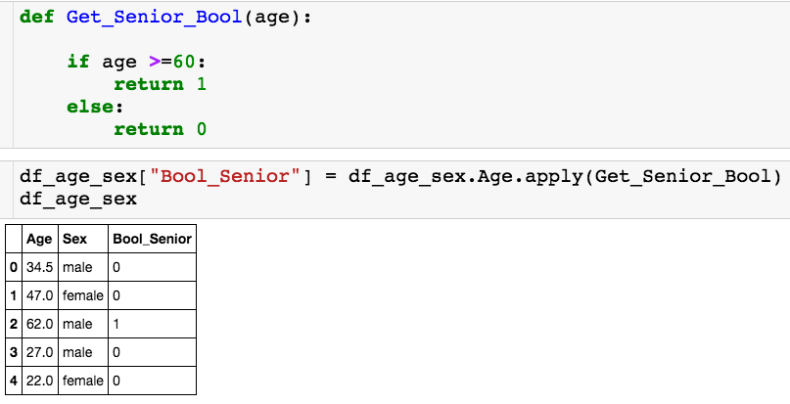
Using Apply
Let’s see how we can use apply with a custom function on a single column:
I’ll apply my custom function on the age column.

Slide 9
Using Apply
Let’s see how we can use apply with a custom function on a single column:
I’ll apply my custom function on the age column.

Slide 10
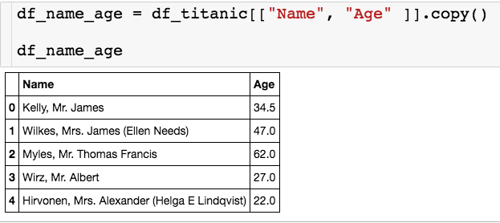
Using Apply
Last one:
Let’s use apply to a new column called Title that’s stores each passenger’s title (Mr./Mrs.)

Slide 11
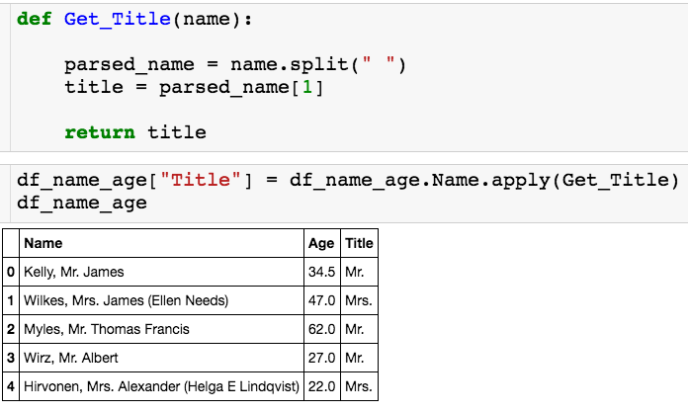
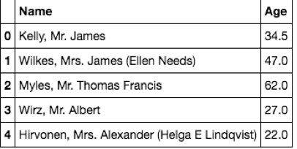
Using Apply
Last one:

Slide 12
Using Apply
Last one:

Slide 13
Using Apply
Let’s see how we can use apply with a custom function on a data frame:
Let’s use apply to create a binary column is 1 if the passenger is male and over 60 and 0 otherwise.

Slide 14
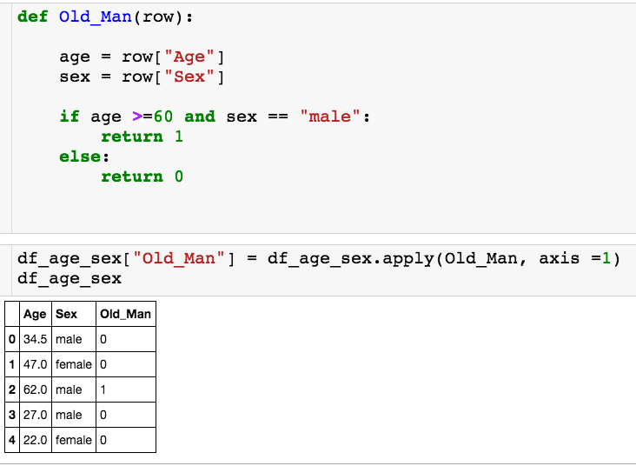
Using Apply
Let’s see how we can use apply with a custom function on a data frame:
Apply to entire dataframe
Apply to rows

Slide 15
Using Apply
Let’s see how we can use apply with a custom function on a data frame:
Apply to entire dataframe
Apply to rows

Slide 16
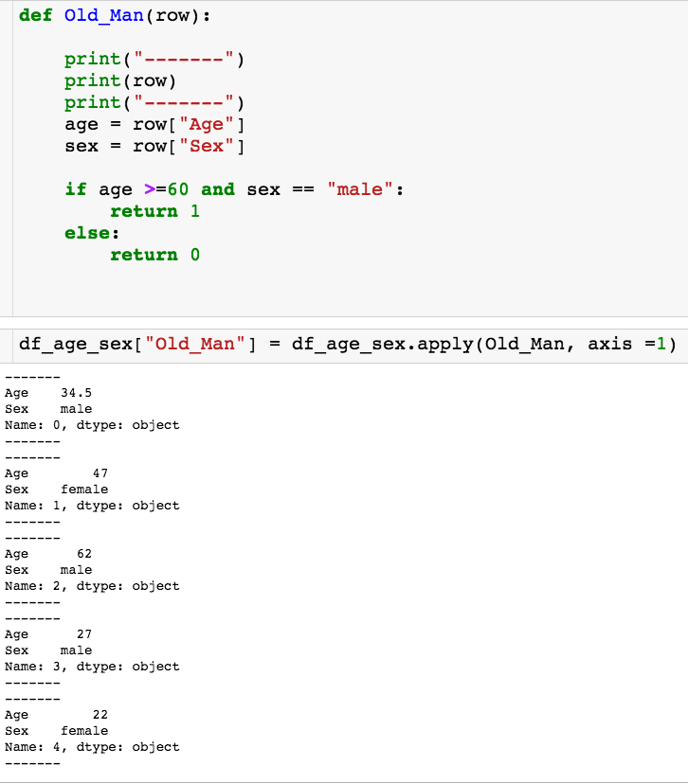
Using Apply
Let’s see how we can use apply with a custom function on a data frame:
The function Old_Man gets called for each row in the dataframe.

Slide 17
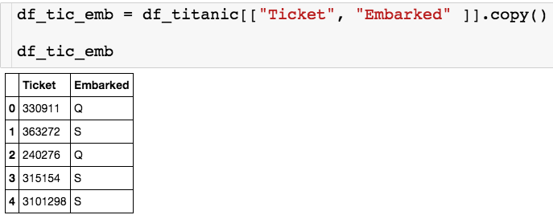
Using Apply
One more example:
I want to create a new column is embarked plus the first number of the ticket. So, in the first row, this new column should read “Q3”

Slide 18
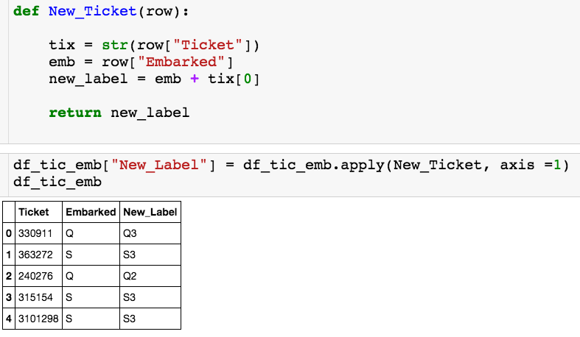
Using Apply
One more example:

Slide 19
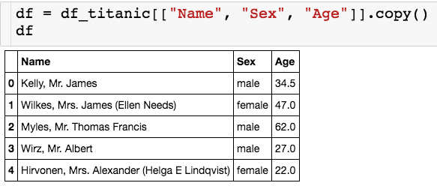
Iterrows
You can use the iterrows() method to go through the rows of a dataframe using a for loop.

Slide 20
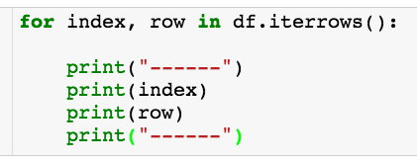
Iterrows
Returns two loop variables
Index of df
Row as series

Slide 21
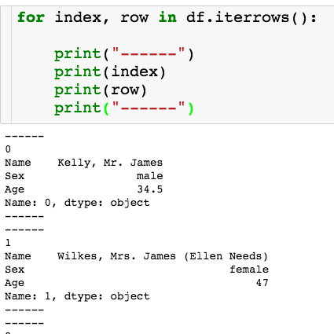
Iterrows

Slide 22
Iterrows
Let’s say I want to create a dictionary where I have an entry for each passenger where the key is the last name and the value is the age.

Slide 23
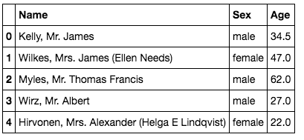
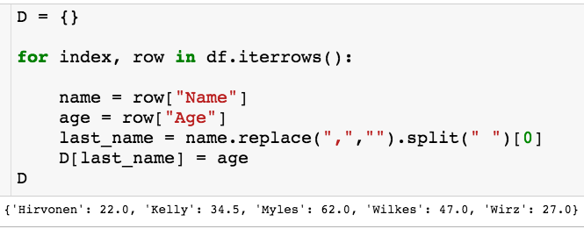
Iterrows

